Slide 1

Universum Talent Research 2021
Partner Report | North West University (NWU)
South African Students Survey 2021 | Students | All main fields of study

Slide 2
Table of contents
  1
  INTRODUCTION
  2
  TALENT PROFILE
  3
  UNIVERSITY AND BRAND PERCEPTION
  4
  CAREER SERVICES
  5
COMMUNICATION
  6
CAREER AND EMPLOYER PREFERENCES
  7
SUMMARY

Slide 3
Table of contents
  1
In this section you will learn:
How Universum works
How you can use this report
  INTRODUCTION

Slide 4















Thank you for working with us this year!
2021 | South Africa | Students | All main fields of study
Today
At the start of the field period, we sent you all the information about the survey period
You helped do a final push of CareerTest send outs before the end of the field period
We sent you your unique CareerTest link, pictures and texts for send outs
You did CareerTest send outs to your students and/or professionals
We’ve prepared your report and are presenting it to you today.

Slide 5






















How we collect our data
2021 | South Africa | Students | All main fields of study
We collaborate with partners around the globe to help create a more transparent world around education and career readiness.
As part of our mission to connect talent with the future, we go straight to the source using our flagship tool, the CareerTest by Universum.
We collaborate with partners all over the world, including universities, student associations and related organisations.
We not only help partners better understand their students, alumni and professionals but we also give relevant career advice and even help with how partners can increase collaboration with top employers.

Slide 6




This report helps you to…
2021 | South Africa | Students | All main fields of study
UNDERSTAND
YOUR STUDENTS
LEARN
ABOUT YOUR BRAND
DEVELOP
FROM COMPARISONS
Dive into your students’ career & communication preferences.
Understand why students are (not) satisfied with your career services.
Get a reality check of your students’ expectations – will their expectations be met in the labor market?
Gauge your students’ opinion on your university brand.
Learn what is unique about your university brand.
Understand where your university and its perception by your students is standing in the market.
Compare different groups of students internally as well as with other students on national and international levels.
Pinpoint your students’ skills in comparison to their peers.
Compare your students’ employer preferences with those of other students.

Slide 7
Table of contents
  1
This chapter focuses on the demographic background of your talent, their competencies, their experiences and how they relate to the comparison group.
These results will help you to contextualize findings in later sections and have a starting point in improving the employability of your talent by being able to communicate their unique value to employers.
  INTRODUCTION
  2
  TALENT PROFILE

Slide 8

The Universum CareerTest 2021
2021 | South Africa | Students | All main fields of study
The Questionnaire
Our survey is conducted online. The link was distributed via university and talent-networks, student communities, the Universum Panel and various other local and global partners.
Survey participants
Students at higher educational institutions
Number of survey participants in this report
FIELD PERIOD
September 2020 - February 2021
Your students
8 125
Total number of
Survey participants
93 641
All students
93 641
Total number of
Survey participants last year
4 082
54 763
Your students last year

Slide 9
The Universum CareerTest 2021
2021 | South Africa | Students | NWU | All main fields of study
The Questionnaire
Our survey is conducted online. The link was distributed via university and talent-networks, student communities, the Universum Panel and various other local and global partners.
Survey participants
Students at higher educational institutions
Number of survey participants in this report
FIELD PERIOD
September 2020 - February 2021
Potchefstroom Campus Students
4 540
Total number of
NWU participants
8 125
Mahikeng Campus Students
1 619
Total number of
Survey participants
1 966
93 641
Vanderbijlpark Campus Students

Slide 10
Demographic profile of talent covered in this report
2021 | South Africa | Students | All main fields of study
Gender
Women
Men

Slide 11
Degrees
2021 | South Africa | Students | All main fields of study
Your students
All students
What qualification or degree are you currently pursuing?

Slide 12
The Universum CareerTest 2021
2021 | South Africa | Professionals | All main fields of study
The Questionnaire
Our survey is conducted online. The link was distributed via university and talent-networks, alumni communities, the Universum Panel and various other local and global partners.
Survey participants
Professionals with an academic degree
Number of survey participants in this report
FIELD PERIOD
September 2020 - February 2021
Your alumni
2 833
Total number of
Survey participants
38 435
All professionals
38 435
Total number of
Survey participants last year
814
25 759
Your alumni last year

Slide 13
Demographic profile of talent covered in this report
2021 | South Africa | Professionals | All main fields of study
Gender
Women
Men

Slide 14
Highest educational qualification
2021 | South Africa | Professionals | All main fields of study
Your alumni
All professionals
What's the highest educational qualification or degree that you've earned?

Slide 15





2021 | South Africa | Students | All main fields of study
The Universum Career Profiles
Go-Getter
Go-Getters have a strong performance orientation. They’re ambitious achievers, hungry to make their mark in successful companies with a reputation for top talent. They’re comfortable taking on high levels of responsibility and tough challenges. In return for their dedicated effort and ability to make things happen, they expect high levels of recognition and fast-track career progress.
Globe-Trotter
Globe-Trotters have a strong international orientation. They have a cosmopolitan outlook, seeking to broaden their horizons in a multi-national company that will provide the opportunity to travel abroad and interact with a diverse international community of colleagues, clients and customers. They see constant change as a positive, broadening their experience and stimulating their learning.
Ground-Breaker
Ground-Breakers have a strong entrepreneurial orientation. They’d ideally prefer to work within a dynamic, team-oriented, start-up environment, with a strong focus on innovation. They’re less interested in working for an established player, and more focused on embracing the latest technologies to create new and exciting products, and lead developments in their chosen field.
Change-Maker
Change-Makers have a strong purpose orientation. They’re altruistic by nature and seek organisations that serve the common good, through public service, or social enterprise. They’re strong believers in diversity, equity and inclusion, and feel most engaged when they’re serving a higher purpose or simply helping people.
Balance-Seeker
Balance-Seekers have a strong work-life balance orientation. They generally seek well-established, small to medium sized organisations with a friendly, family feel, providing a decent salary and the flexibility for people to balance their responsibilities at work with their wider interests and responsibilities outside of work.

Slide 16

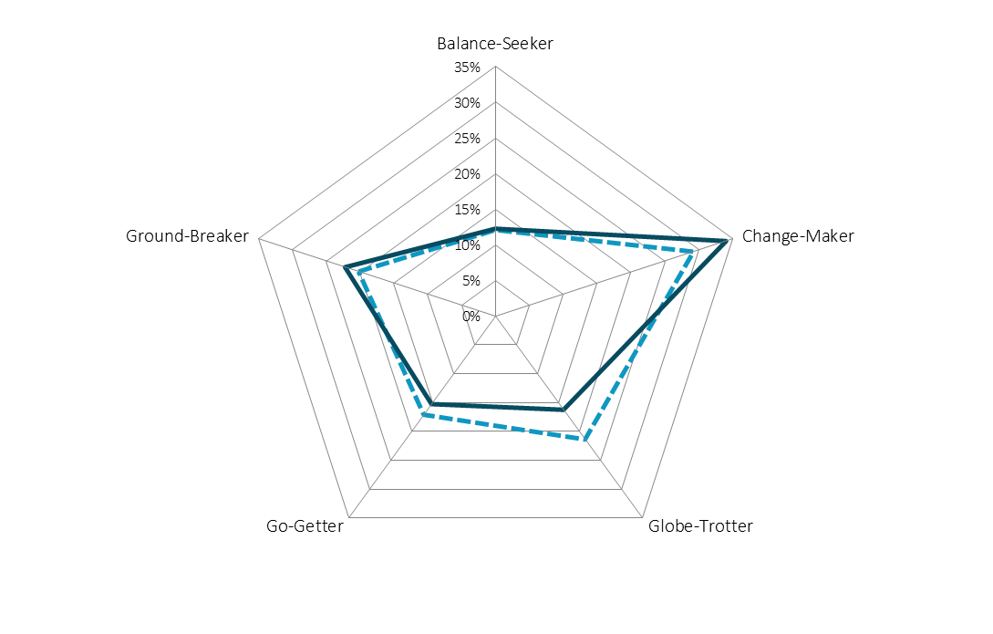




The Universum Career Types
2021 | South Africa | Students | All main fields of study
DOMINANT CAREER TYPES:
Your students
Change-Maker
Globe-Trotter
Ground-Breaker
Your students
All students
DOMINANT CAREER TYPES:
All students
Change-Maker
Ground-Breaker
Globe-Trotter

Slide 17
Your student's soft skills assessment (1/2)
2021 | South Africa | Students | All main fields of study
I'm able to clearly communicate what I want to say most of the time
I tend to challenge the status quo and create new things
Strongly agree
Agree
Slightly agree
I feel confident when I have challenging problems to solve
I work better on my own than in a team
Slightly disagree
Disagree
Strongly disagree
How much do you agree with the following statements?

Slide 18
Your student's soft skills assessment (2/2)
2021 | South Africa | Students | All main fields of study
I find it easy to learn new skills
I tend to take initiatives to make things happen
Strongly agree
Agree
Slightly agree
I like frequent change
I feel most engaged when I'm helping people
Slightly disagree
Disagree
Strongly disagree
How much do you agree with the following statements?

Slide 19
Practical experiences (1/2)
2021 | South Africa | Students | All main fields of study
Your students
All students
Which of the following experiences do you have? Please select as many as applicable.

Slide 20
Practical experiences (2/2)
2021 | South Africa | Students | All main fields of study
Your students
All students
Which of the following experiences do you have? Please select as many as applicable.

Slide 21
Table of contents
  1
This chapter evaluates your university brand perception with regards to four different drivers:
Reputation
Offering
Culture
Employability
This will help you adjust your communication towards current students as well as determine which topics are best suited for use when attracting new students.
  INTRODUCTION
  2
  TALENT PROFILE
  3
  UNIVERSITY AND BRAND PERCEPTION

Slide 22

What do your students think about your university?
2021 | South Africa | Students | All main fields of study
What's the first word that comes to your mind when you think of your college or university?
These are answers were provided by your talent.
Spelling mistakes might occur.
Different colors have been used for design purposes only & reflect the associations of your talent.

Slide 23

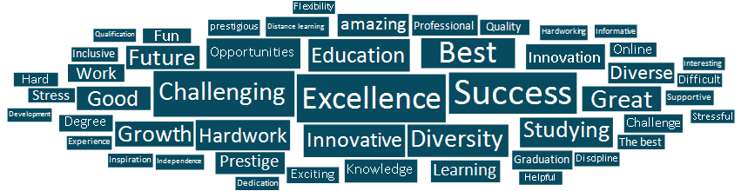
Is your image distinct?
2021 | South Africa | Students | All main fields of study
Your students
All students
What's the first word that comes to your mind when you think of your college or university?
These are answers were provided by your talent.
Spelling mistakes might occur.
Different colors have been used for design purposes only & reflect the associations of your talent.

Slide 24

What do your Potchefstroom Campus students think about your university?
2021 | South Africa | Students | NWU | All main fields of study
What's the first word that comes to your mind when you think of your college or university?
These are answers were provided by your talent.
Spelling mistakes might occur.
Different colors have been used for design purposes only & reflect the associations of your talent.

Slide 25

What do your Mahikeng Campus students think about your university?
2021 | South Africa | Students | NWU | All main fields of study
What's the first word that comes to your mind when you think of your college or university?
These are answers were provided by your talent.
Spelling mistakes might occur.
Different colors have been used for design purposes only & reflect the associations of your talent.

Slide 26

What do your Vanderbijlpark Campus students think about your university?
2021 | South Africa | Students | NWU | All main fields of study
What's the first word that comes to your mind when you think of your college or university?
These are answers were provided by your talent.
Spelling mistakes might occur.
Different colors have been used for design purposes only & reflect the associations of your talent.

Slide 27

What do your alumni think about your university?
2021 | South Africa | Professionals | All main fields of study
What's the first word that comes to your mind when you think of your college or university?
These are answers were provided by your talent.
Spelling mistakes might occur.
Different colors have been used for design purposes only & reflect the associations of your talent.

Slide 28

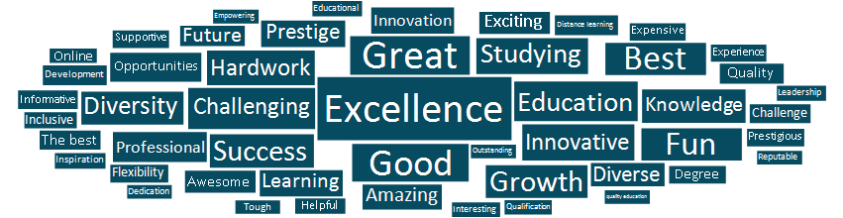
Is your image distinct?
2021 | South Africa | Professionals | All main fields of study
Your alumni
All professionals
What's the first word that comes to your mind when you think of your college or university?
These are answers were provided by your talent.
Spelling mistakes might occur.
Different colors have been used for design purposes only & reflect the associations of your talent.

Slide 29
Influences on decisions where to study
2021 | South Africa | Students | All main fields of study
Your students
All students
What helped you most when choosing your college and university? (Please select a maximum of 3 alternatives.)

Slide 30
Less important influence factors for your school’s selection
2021 | South Africa | Students | All main fields of study
Your students
All students
What helped you most when choosing your college and university? (Please select a maximum of 3 alternatives.)

Slide 31
Would talent choose their university again?
2021 | South Africa | Students | All main fields of study
Your students
All students
Attend a different college or university within this country
Attend a different college or university within this country
Attend a college or university abroad
Attend a college or university abroad
Attend the same college or university
Attend the same college or university
Seek employment instead of going to college or university
Seek employment instead of going to college or university
If you were to restart your studies, what would you do?

Slide 32
Would talent choose their university again? (Potchefstroom Campus)
2021 | South Africa | Students | NWU | All main fields of study
Potchefstroom Campus Students
All NWU Students
Attend a different college or university within this country
Attend a different college or university within this country
Attend a college or university abroad
Attend a college or university abroad
Attend the same college or university
Attend the same college or university
Seek employment instead of going to college or university
Seek employment instead of going to college or university
If you were to restart your studies, what would you do?

Slide 33
Which universities would your Potchefstroom campus students choose instead?
2021 | South Africa | Students | NWU | All main fields of study
Universities your students would have chosen instead (Percent)
  1. University of Pretoria (UP) (28%)
  2. Stellenbosch University (SUN) (17%)
  3. University of Witwatersrand (WITS) (17%)
  4. University of Cape Town (UCT) (12%)
  5. University of Johannesburg (UJ) (6%)
  7. University of the Free State (UFS) (4%)
  8. University of South Africa (UNISA) (3%)
  9. Sefako Makgatho University (SMU) (1%)
  9. University of KwaZulu Natal (UKZN) (1%)
  9. Vega School (1%)
14%
…of your students said they would attend a different college or university in your country if they could choose again
WHERE ARE THESE SCHOOLS STRONGER THAN YOU ARE?
They are associated with these important attributes to a higher extent than you are!
  Research excellence
  Institutional commitment to diversity and inclusion
  Support for gender equality
  Successful alumni
  Drives changes in society
If you were to restart your studies, what would you do?
Which university or college would you rather have attended?
Which of the following attributes do you associate with your college or university? (Please select as many as applicable.)

Slide 34
Would talent choose their university again? (Mahikeng Campus)
2021 | South Africa | Students | NWU | All main fields of study
Mahikeng Campus Students
All NWU Students
Attend a different college or university within this country
Attend a different college or university within this country
Attend a college or university abroad
Attend a college or university abroad
Attend the same college or university
Attend the same college or university
Seek employment instead of going to college or university
Seek employment instead of going to college or university
If you were to restart your studies, what would you do?

Slide 35
Which universities would your Mahikeng Campus students choose instead?
2021 | South Africa | Students | NWU | All main fields of study
Universities your students would have chosen instead (Percent)
  1. University of Pretoria (UP) (25%)
  2. University of Witwatersrand (WITS) (21%)
  3. University of Johannesburg (UJ) (18%)
  4. University of Cape Town (UCT) (14%)
  5. Stellenbosch University (SUN) (4%)
  6. University of South Africa (UNISA) (4%)
  8. University of the Free State (UFS) (2%)
  9. Rhodes University (RU) (1%)
  9. Tshwane University of Technology (TUT) (1%)
  9. University of Mpumalanga ( UMP) (1%)
29%
…of your students said they would attend a different college or university in your country if they could choose again
WHERE ARE THESE SCHOOLS STRONGER THAN YOU ARE?
They are associated with these important attributes to a higher extent than you are!
  High quality of programs
  Good reference for future career and/or education
  Good employment opportunities
  Creative and dynamic atmosphere
  Stimulating learning environment
If you were to restart your studies, what would you do?
Which university or college would you rather have attended?
Which of the following attributes do you associate with your college or university? (Please select as many as applicable.)

Slide 36
Would talent choose their university again? (Vanderbijlpark Students)
2021 | South Africa | Students | NWU | All main fields of study
Vanderbijlpark Students
All NWU Students
Attend a different college or university within this country
Attend a different college or university within this country
Attend a college or university abroad
Attend a college or university abroad
Attend the same college or university
Attend the same college or university
Seek employment instead of going to college or university
Seek employment instead of going to college or university
If you were to restart your studies, what would you do?

Slide 37
Which universities would your Vanderbijlpark Campus students choose instead?
2021 | South Africa | Students | NWU | All main fields of study
Universities your students would have chosen instead (Percent)
  1. University of Witwatersrand (WITS) (21%)
  2. University of Pretoria (UP) (20%)
  3. University of Cape Town (UCT) (18%)
  3. University of Johannesburg (UJ) (18%)
  6. University of South Africa (UNISA) (4%)
  7. Stellenbosch University (SUN) (4%)
  8. University of the Free State (UFS) (3%)
  9. Nelson Mandela University (NMU) (2%)
  9. University of the Western Cape (UWC) (2%)
  11. Boston City Campus and Business College (1%)
22%
…of your students said they would attend a different college or university in your country if they could choose again
WHERE ARE THESE SCHOOLS STRONGER THAN YOU ARE?
They are associated with these important attributes to a higher extent than you are!
  Affordability of studies
  Research excellence
  Drives changes in society
  Good employment opportunities
  High quality of programs
If you were to restart your studies, what would you do?
Which university or college would you rather have attended?
Which of the following attributes do you associate with your college or university? (Please select as many as applicable.)

Slide 38
Would talent choose their university again?
2021 | South Africa | Professionals | All main fields of study
Your alumni
All professionals
Attend a different college or university within this country
Attend a different college or university within this country
Attend a college or university abroad
Attend a college or university abroad
Attend the same college or university
Attend the same college or university
Seek employment instead of going to college or university
Seek employment instead of going to college or university
If you were to restart your studies, what would you do?

Slide 39
Which universities would your alumni choose instead?
2021 | South Africa | Professionals | All main fields of study
Universities your alumni would have chosen instead (Percent)
  1. University of Pretoria (UP) (19%)
  2. University of Cape Town (UCT) (17%)
  3. University of Witwatersrand (WITS) (17%)
  4. Stellenbosch University (SUN) (11%)
  5. University of Johannesburg (UJ) (9%)
  7. University of South Africa (UNISA) (3%)
  7. University of the Free State (UFS) (3%)
  9. University of KwaZulu Natal (UKZN) (2%)
  10. Rhodes University (RU) (1%)
  10. Sefako Makgatho University (SMU) (1%)
18%
…of your alumni said they would attend a different college or university in your country if they could choose again
WHERE ARE THESE SCHOOLS STRONGER THAN YOU ARE?
They are associated with these important attributes to a higher extent than you are!
  Internationally renowned
  Good employment opportunities
  Good reference for future career and/or education
  Opportunities to network with employers
  Research excellence
If you were to restart your studies, what would you do?
Which university or college would you rather have attended?
Which of the following attributes do you associate with your college or university? (Please select as many as applicable.)

Slide 40
The Universum Drivers of University Attractiveness
2021 | South Africa | Students | All main fields of study
Reputation
Culture
Alumni hold leadership positions
Drives changes in society
Drives innovation and/or entrepreneurship
Educational excellence
Heritage and tradition
Internationally renowned
Research excellence
Studying with the best students
Successful alumni
Unique programs
Affordability of studies
Attractive location
Creative and dynamic atmosphere
Friendly and open environment
Good meal plans / cafeterias
Institutional commitment to diversity and inclusion
International student body
Safe campus environment
Support for gender equality
Wide range of extracurricular activities
Employability
Offering
Focus on professional development
Good employment opportunities
Good reference for future career and/or education
Launching pad for international career
Opportunities to network with employers
Strong ties with industry
Supports and develops entrepreneurialism
Supports and develops innovation
Target school for employers in my field
Teaching skills employers are looking for
Adequate teacher/student ratio
Availability of study space
Easy access to study materials
Excellent professors/lecturers
High quality of programs
Interdisciplinary courses
Programs/opportunities to study abroad
Stimulating learning environment
Teaching relevant skills
Variety of courses

Slide 41
The most important attributes - Top 10
2021 | South Africa | Students | All main fields of study
Your students
All students
Reputation
Culture
Employability
Offering
Which of these are most important to you? Please select a maximum of 3 alternatives.

Slide 42
The biggest changes from 2020 to 2021 - Importance
2021 | South Africa | Students | All main fields of study
Your students
All students
Your students
Rank
2021
2020
Rank
2021
2020
Increased in importance
Rank
2021
2020
Rank
2021
2020
Decreased in importance
Reputation
Culture
Employability
Offering
Which of these aspects are most important to you? (Please select a maximum of 3 alternatives.)

Slide 43
The top 10 attributes your students associate with you
2021 | South Africa | Students | All main fields of study
Your students
All students
Your students
Reputation
Culture
Employability
Offering
Which of the following attributes do you associate with your college or university? Select as many as applicable.

Slide 44
The biggest changes from 2020 to 2021 - Association
2021 | South Africa | Students | All main fields of study
Your students
All students
Your students
Rank
2021
2020
Rank
2021
2020
Increased in association
Rank
2021
2020
Rank
2021
2020
Decreased in association
Reputation
Culture
Employability
Offering
Which of the following attributes do you associate with your college or university? Select as many as applicable.

Slide 45
The top 10 attributes your alumni associate with you
2021 | South Africa | Professionals | All main fields of study
Your alumni
All professionals
Your alumni
Reputation
Culture
Employability
Offering
Which of the following attributes do you associate with your college or university? Select as many as applicable.

Slide 46
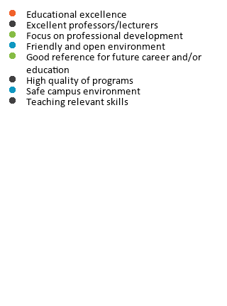
What is attractive and associated with you?
2021 | South Africa | Students | All main fields of study
Attractive and associated attributes
Associated
Associated
Attractive
Reputation
Culture
Employability
Offering
Which of the following attributes do you associate with your college or university? (Please select as many as applicable.)
Which of these are most important to you? (Please select a maximum of 3 alternatives.)

Slide 47
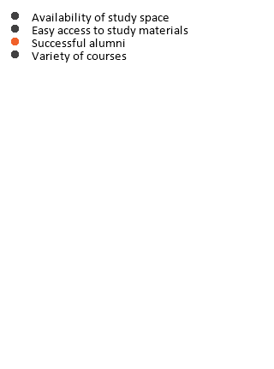
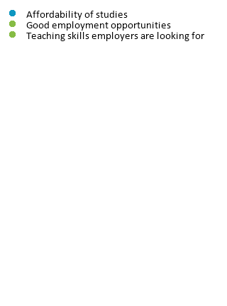

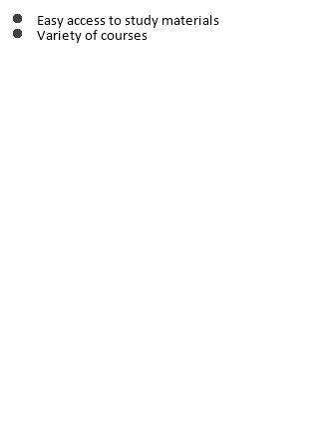
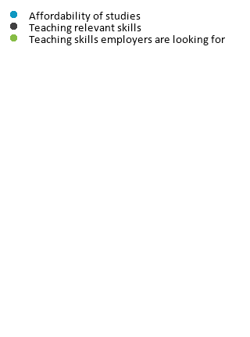
Are your target group’s preferences aligned with their perception of you?
2021 | South Africa | Students | All main fields of study
Associated but not attractive attributes 2021:
Attractive but not associated attributes 2021:
Associated but not attractive attributes 2020:
Attractive but not associated attributes 2020:
Reputation
Culture
Employability
Offering

Slide 48
Competitor comparison
2021 | South Africa | Students | All main fields of study
Understanding what your students think about their school by comparing their ratings to a wider context
100%
Highest value in the comparison group
100%
100%
Example 1:
Very diverse distribution across the different comparison schools.
Strongest 10% of colleges/universiities
Half of the
colleges/
universities
has a value in
this range
90%
90%
90%
80%
70%
Percentage of students who associate their college/
university with the attribute
80%
Your performance
80%
Strongest 10-20%
60%
50%
70%
70%
Strongest 20-30%
40%
30%
60%
60%
Strongest 30-40%
20%
10%
50%
50%
Strongest 40-50%
0%
Average performance
40%
40%
Weakest 40-50%
Half of the
colleges/
universities
has a value in
this range
Weakest 30-40%
100%
Example 2:
Very dense distribution across the different comparison schools with a group of outliers at the top.
30%
30%
90%
Weakest 20-30%
80%
20%
20%
70%
Weakest 10-20%
60%
10%
Lowest value in the comparison group
10%
50%
Weakest 10% of colleges/universiities
40%
0%
0%
30%
20%
10%
0%

Slide 49
Where do you stand regarding reputation?
2021 | South Africa | Students | All main fields of study
Your students
Average
Most attractive
Strongest 10-20%
Strongest 20-30%
Strongest 30-40%
Strongest 40-50%
Weakest 40-50%
Weakest 30-40%
Weakest 20-30%
Weakest 10-20%
Weakest 10%
Minimum
Maximum
The attributes are sorted by importance
Which college or university do you attend? / At which college or university did you achieve your highest academic degree?.
Which of the following attributes do you associate with your college or university? (Please select as many as applicable.)
Which of these aspects are most important to you? (Please select a maximum of 3 alternatives.)

Slide 50
Where do you stand regarding offering?
2021 | South Africa | Students | All main fields of study
Your students
Average
Most attractive
Strongest 10-20%
Strongest 20-30%
Strongest 30-40%
Strongest 40-50%
Weakest 40-50%
Weakest 30-40%
Weakest 20-30%
Weakest 10-20%
Weakest 10%
Minimum
Maximum
The attributes are sorted by importance
Which college or university do you attend? / At which college or university did you achieve your highest academic degree?.
Which of the following attributes do you associate with your college or university? (Please select as many as applicable.)
Which of these aspects are most important to you? (Please select a maximum of 3 alternatives.)

Slide 51
Where do you stand regarding culture?
2021 | South Africa | Students | All main fields of study
Your students
Average
Most attractive
Strongest 10-20%
Strongest 20-30%
Strongest 30-40%
Strongest 40-50%
Weakest 40-50%
Weakest 30-40%
Weakest 20-30%
Weakest 10-20%
Weakest 10%
Minimum
Maximum
The attributes are sorted by importance
Which college or university do you attend? / At which college or university did you achieve your highest academic degree?.
Which of the following attributes do you associate with your college or university? (Please select as many as applicable.)
Which of these aspects are most important to you? (Please select a maximum of 3 alternatives.)

Slide 52
Where do you stand regarding employability?
2021 | South Africa | Students | All main fields of study
Your students
Average
Most attractive
Strongest 10-20%
Strongest 20-30%
Strongest 30-40%
Strongest 40-50%
Weakest 40-50%
Weakest 30-40%
Weakest 20-30%
Weakest 10-20%
Weakest 10%
Minimum
Maximum
The attributes are sorted by importance
Which college or university do you attend? / At which college or university did you achieve your highest academic degree?.
Which of the following attributes do you associate with your college or university? (Please select as many as applicable.)
Which of these aspects are most important to you? (Please select a maximum of 3 alternatives.)

Slide 53
Which driver is your brand leaning to according to your students ?
2021 | South Africa | Students | All main fields of study
University Reputation
and Image
Culture
Your students
associate
18
out of 40 attributes with their school. Other students associate 16 attributes with their schools.
4 attributes
5 attributes
Employability & Future
Opportunities
Offering
4 attributes
5 attributes
Which of the following attributes do you associate with your college or university? (Please select as many as applicable.)
Note, the list of attributes shown here cuts across all four Drivers of Employer Attractiveness (i.e. out of 40 attributes), as opposed to by each individual Driver.
Outer circle shows data of Your students.
Inner circle shows data of All students.

Slide 54
Where do you stand regarding reputation?
2021 | South Africa | Professionals | All main fields of study
Your alumni
Average
Most attractive
Strongest 10-20%
Strongest 20-30%
Strongest 30-40%
Strongest 40-50%
Weakest 40-50%
Weakest 30-40%
Weakest 20-30%
Weakest 10-20%
Weakest 10%
Minimum
Maximum
The attributes are sorted by importance
Which college or university do you attend? / At which college or university did you achieve your highest academic degree?.
Which of the following attributes do you associate with your college or university? (Please select as many as applicable.)
Which of these aspects are most important to you? (Please select a maximum of 3 alternatives.)

Slide 55
Where do you stand regarding offering?
2021 | South Africa | Professionals | All main fields of study
Your alumni
Average
Most attractive
Strongest 10-20%
Strongest 20-30%
Strongest 30-40%
Strongest 40-50%
Weakest 40-50%
Weakest 30-40%
Weakest 20-30%
Weakest 10-20%
Weakest 10%
Minimum
Maximum
The attributes are sorted by importance
Which college or university do you attend? / At which college or university did you achieve your highest academic degree?.
Which of the following attributes do you associate with your college or university? (Please select as many as applicable.)
Which of these aspects are most important to you? (Please select a maximum of 3 alternatives.)

Slide 56
Where do you stand regarding culture?
2021 | South Africa | Professionals | All main fields of study
Your alumni
Average
Most attractive
Strongest 10-20%
Strongest 20-30%
Strongest 30-40%
Strongest 40-50%
Weakest 40-50%
Weakest 30-40%
Weakest 20-30%
Weakest 10-20%
Weakest 10%
Minimum
Maximum
The attributes are sorted by importance
Which college or university do you attend? / At which college or university did you achieve your highest academic degree?.
Which of the following attributes do you associate with your college or university? (Please select as many as applicable.)
Which of these aspects are most important to you? (Please select a maximum of 3 alternatives.)

Slide 57
Where do you stand regarding employability?
2021 | South Africa | Professionals | All main fields of study
Your alumni
Average
Most attractive
Strongest 10-20%
Strongest 20-30%
Strongest 30-40%
Strongest 40-50%
Weakest 40-50%
Weakest 30-40%
Weakest 20-30%
Weakest 10-20%
Weakest 10%
Minimum
Maximum
The attributes are sorted by importance
Which college or university do you attend? / At which college or university did you achieve your highest academic degree?.
Which of the following attributes do you associate with your college or university? (Please select as many as applicable.)
Which of these aspects are most important to you? (Please select a maximum of 3 alternatives.)

Slide 58
University satisfaction
2021 | South Africa | Students | All main fields of study
Not at all satisfied
Extremely satisfied
Average rate 2021:
Average rate 2021:
8,2
7,7
Your students
All students
How satisfied are/were you with your college or university?

Slide 59
University satisfaction over time
2021 | South Africa | Students | All main fields of study
Average rate 2021
8,2
Your students
Average rate 2021
7,7
All students
Your students
All students
How satisfied are/were you with your college or university?

Slide 60
Satisfaction across gender per main field of study
2021 | South Africa | Students | All main fields of study
Female
Male
Your students
All students
How satisfied are/were you with your college or university?

Slide 61
Satisfaction with online classes during COVID-19
2021 | South Africa | Students | All main fields of study
Poor
Excellent
Average rate 2021:
Average rate 2021:
7,7
7,4
Your students
All students
How satisfied are you with how your university or college handled offering online classes during the COVID-19 situation? (0 - Poor, 10 - Excellent)

Slide 62
Table of contents
  1
This chapter illustrates which career services your talent uses, which services they deem important, and how satisfied they are with the currently offered services.
This will help you to tactically focus on the career services that are in highest demand and are most effective for your talent
  INTRODUCTION
  2
TALENT PROFILE
  3
  UNIVERSITY AND BRAND PERCEPTION
  4
  CAREER SERVICES

Slide 63
The most useful career services (1/2)
2021 | South Africa | Students | All main fields of study
Your students
All students
Which of these career services do you find the most useful? (Please select a maximum of 3 alternatives.)

Slide 64
The most useful career services (2/2)
2021 | South Africa | Students | All main fields of study
Your students
All students
Which of these career services do you find the most useful? (Please select a maximum of 3 alternatives.)

Slide 65
The most used career services (1/2)
2021 | South Africa | Students | All main fields of study
Your students
All students
Which of these career services have you used at your college or university? (Please select as many as applicable.)

Slide 66
The most used career services (2/2)
2021 | South Africa | Students | All main fields of study
Your students
All students
Which of these career services have you used at your college or university? (Please select as many as applicable.)

Slide 67
Career services your students did not use due to COVID-19
2021 | South Africa | Students | All main fields of study
Your students
All students
Which of these career services did you not use because access to them was limited due to the COVID-19 situation?(Please select as many as applicable.)
Based on their reply if they used specific career services or not your students were asked if they didn’t use these services due to COVID-19

Slide 68
The biggest changes from 2020 to 2021 – Career Service Usage
2021 | South Africa | Students | All main fields of study
Your students
All students
Your students
Career/job/internship fairs 33% (26%)
Recruitment talks 20% (19%)
Coaching/mentorship program 17% (16%)
Job search training 19% (17%)
University-run job board 9% (8%)
Case studies by employers 12% (12%)
Increased in usage
Visiting companies/organisations 12% (14%)
Information about career tracks 21% (24%)
Personality or skills testing 27% (31%)
Coaching/mentorship program 18% (20%)
Visiting companies/organisations 13% (15%)
Employer presentations 17% (19%)
Decreased in usage
Which of these career services have you used at your college or university? (Please select as many as applicable.)
The numbers next to career services shows 2021 percentage with 2020 percentage in ().

Slide 69
Are your students using the career services they find important?
2021 | South Africa | Students | All main fields of study
Important career services your students use less
–
Unmet demand
Important career services that your students use more
–
Success story
Importance of career services
Less important career services your students use less
–
No action
Less important career services your students use more
–
Baseline expectation
Career services’ usage among your students

Slide 70
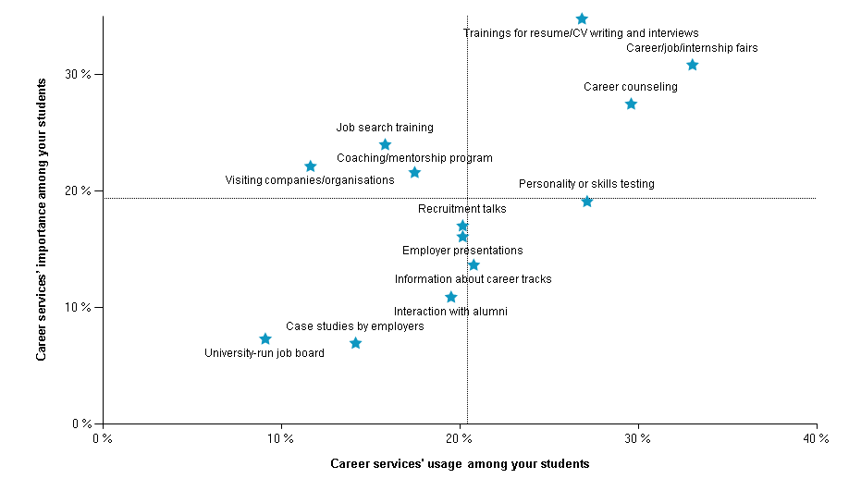
Career services demand versus usage
2021 | South Africa | Students | All main fields of study
Which of these career services do you find the most useful? (Please select a maximum of 3 alternatives.)
Which of these career services have you used at your college or university? (Please select as many as applicable.)

Slide 71
General usage of career services
2021 | South Africa | Students | All main fields of study
Your students
All students
Share of students using one or more career services at their university
Share of students using one or more career services at their university
Share of students not using any career service at their university
Share of students not using any career service at their university
Which of these career services have you used at your college or university? Select as many as applicable.
Average rate 2019:
Average rate 2019:

Slide 72
% of students not using any career services
2021 | South Africa | Students | All main fields of study
% of students not using any career services
Your students
Year
All students
Which of these career services have you used at your college or university? Select as many as applicable.
Average rate 2019:
Average rate 2019:

Slide 73
Why are some students not using any of the career services?
2021 | South Africa | Students | All main fields of study
Your students
All students
Why haven't you used the career services offered at your college or university?

Slide 74
Satisfaction with career services
2021 | South Africa | Students | All main fields of study
Poor
Excellent
Average rate 2021:
Average rate 2021:
7,2
7,2
Your students
All students
How would you rate the career services offered at your college or university? (0 - Poor, 10 - Excellent)

Slide 75
Career service satisfaction over time
2021 | South Africa | Students | All main fields of study
Average rate 2021
7,2
Your students
Average rate 2021
7,2
All students
Your students
All students
How would you rate the career services offered at your college or university? (0 - Poor, 10 - Excellent)
The X-axis of the chart was limited to the score values 4 to 10 for better readability

Slide 76
Satisfaction with career services during COVID-19
2021 | South Africa | Students | All main fields of study
Poor
Excellent
Average rate 2021:
Average rate 2021:
7,4
7,3
Your students
All students
How satisfied are you with how your university or college handled offering career services during the COVID-19 situation? (0 - Poor, 10 - Excellent)

Slide 77
Recommended communication channels for career service information
2021 | South Africa | Students | All main fields of study
Your students
All students
What channels would you like your career services to use to communicate with you? (Please select as many as applicable.)

Slide 78
Table of contents
  1
This chapter covers how your talent prefers to communicate and interact with employers.
This will assist you in indicating to your talent in where their peers are successful communicators. Additionally, this data educates employers regarding which platforms they should use to engage your talent.
  INTRODUCTION
  2
  TALENT PROFILE
  3
  UNIVERSITY AND BRAND PERCEPTION
  4
  CAREER SERVICES
  5
COMMUNICATION

Slide 79
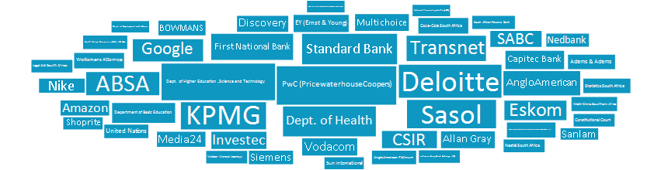
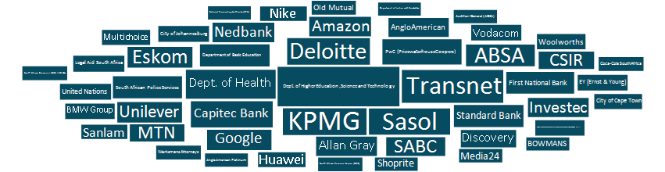
Best recruiting activities
2021 | South Africa | Students | All main fields of study
Your students
All students
Which employer has impressed you the most with their recruitment activities at your college/university in the past 12 months?

Slide 80
Communication channels – Top 15
2021 | South Africa | Students | All main fields of study
Your students
All students
Through which channels have you learnt about these employers in the last 12 months?

Slide 81
Sources talent rely on the most when selecting an employer
2021 | South Africa | Students | All main fields of study
Your students
All students
In general, which sources do you rely on the most when selecting an employer to work for? (Please select a maximum of 3 alternatives.)

Slide 82
Preferred format for participation
2021 | South Africa | Students | All main fields of study
Your students
How would you prefer to participate in the following activities?

Slide 83
Most used online platforms
2021 | South Africa | Students | All main fields of study
Used in general
Used to learn about employers
Your students
All students
Which of these online platforms do you use? (Please choose as many as applicable.)
Which of these platforms do you use to inform yourself about employers? (Please choose as many as applicable.)

Slide 84
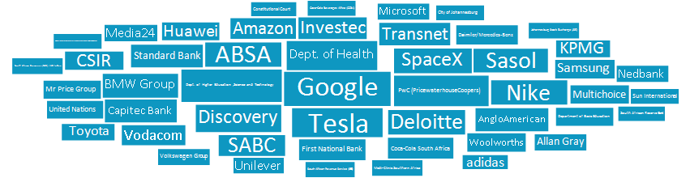
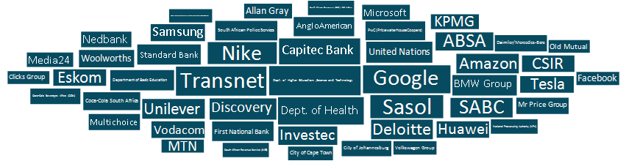
Employers with the most impressive social media presence
2021 | South Africa | Students | All main fields of study
Your students
All students
Which employer has impressed you the most with its social media activities in the last 12 months?

Slide 85
Table of contents
  1
This chapter focuses on the employer attributes that are most attractive to your talent Moreover, it covers your talent’s preferred choice of employers, including their ideal employers.
You will discover how well aligned your talent’s preferences are with the reality of the labor market. You can thereby identify which employers are top of mind for your talent and which ones are not currently successful at attracting your talent.
  INTRODUCTION
  2
  TALENT PROFILE
  3
  UNIVERSITY AND BRAND PERCEPTION
  4
  CAREER SERVICES
  5
COMMUNICATION
  6
CAREER AND EMPLOYER PREFERENCES

Slide 86
Preferred type of employment
2021 | South Africa | Students | All main fields of study
Your students
All students
Full time
Full time
Part time
Part time
Freelance/ gig-work
Freelance/ gig-work
What type of employment would you prefer?

Slide 87
Organization type preferences | Your students vs All students
2021 | South Africa | Students | All main fields of study
Organizational maturity
Size
Operations
Established organization
Large organization
Organization with operations mainly in South Africa
Start-up
Small to medium sized organization
Organization with global operations
Origin
Sector
Location
Organization founded in South Africa
Private sector
Large city
Organization founded outside of South Africa
Public sector
Small to medium sized town
If you have to choose one, where would you prefer to work?

Slide 88
Organization type preferences | Gender comparison
2021 | South Africa | Students | All main fields of study
Organizational maturity
Size
Operations
Established organization
Large organization
Organization with operations mainly in South Africa
Start-up
Small to medium sized organization
Organization with global operations
Origin
Sector
Location
Organization founded in South Africa
Private sector
Large city
Organization founded outside of South Africa
Public sector
Small to medium sized town
If you have to choose one, where would you prefer to work?

Slide 89
Your students' most preferred industries
2021 | South Africa | Students | All main fields of study
Your students
All students
Which industries are you interested working in after graduation?
These are your students’ ten most prefered industries

Slide 90
Your students' most preferred industries
2021 | South Africa | Students | All main fields of study
Business/Commerce
Your students
All students
Which industries are you interested working in after graduation

Slide 91
Your students' most preferred industries
2021 | South Africa | Students | All main fields of study
Engineering/Technology
Your students
All students
Which industries are you interested working in after graduation?

Slide 92
Your students' most preferred industries
2021 | South Africa | Students | All main fields of study
Sciences
Your students
All students
Which industries are you interested working in after graduation?

Slide 93
Expected salary by gender | Your students vs All students
2021 | South Africa | Students | All main fields of study
Expected annual salary (ZAR)
Your students
All students
284 485
274 068
310 268
303 304
266 223
258 443
GENDER
GAP
44 045
44 862
What salary do you expect to earn in your first full-time job after graduation? (Please provide a before-tax salary, excluding commissions and bonuses.)
Gender

Slide 94
Expected salary by gender | Your students 2021 vs Your students 2020
2021 | South Africa | Students | All main fields of study
Expected annual salary (ZAR)
Your students 2021
Your students 2020
284 485
293 099
310 268
314 251
266 223
281 782
GENDER
GAP
44 045
32 469
What salary do you expect to earn in your first full-time job after graduation? (Please provide a before-tax salary, excluding commissions and bonuses.)
Gender:

Slide 95
Expected annual salary (ZAR)
2021 | South Africa | Students | All main fields of study
Business/Commerce
Engineering/Technology
Sciences
All students 2021
255 185
310 560
293 915
278 264
286 247
335 905
336 275
310 629
244 447
298 600
284 599
266 050
GENDER
GAP
41 799
37 305
51 676
44 579
What salary do you expect to earn in your first full-time job after graduation? (Please provide a before-tax salary, excluding commissions and bonuses)

Slide 96
Current annual salary (ZAR)
2021 | South Africa | Professionals | All main fields of study
Business/Commerce
Engineering/Technology
All Professionals 2021
Sciences
407 434
481 641
415 146
403 884
461 222
509 770
473 315
463 420
356 738
425 585
371 934
355 496
GENDER
GAP
104 484
84 186
101 381
107 924
What is your current salary before taxes (including commission and bonus, excluding pension)?

Slide 97
Expected salary by gender | Your students 2021 vs Your students 2020
2021 | South Africa | Students | All main fields of study
Expected annual salary (ZAR)
Potchefstroom Campus Students
Mahikeng Campus Students
Vanderbijlpark Campus Students
290 401
271 575
281 892
320 078
289 040
305 696
268 546
257 556
267 675
GENDER
GAP
51 532
31 484
38 021
What salary do you expect to earn in your first full-time job after graduation? (Please provide a before-tax salary, excluding commissions and bonuses.)
Gender:

Slide 98
The Universum Drivers of Employer Attractiveness
2021 | South Africa | Students | All main fields of study
Employer Reputation & Image
People & Culture
The attributes of the employer as an organisation
The social environment and attributes of the workplace
Attractive/exciting products and services
Corporate Social Responsibility
Embracing new technologies
Ethical standards
Fast-growing/entrepreneurial
Innovation
Inspiring leadership
Inspiring purpose
Market success
Prestige
A creative and dynamic work environment
A friendly work environment
Commitment to diversity and inclusion
Encouraging work-life balance
Interaction with international clients and colleagues
Leaders who will support my development
Opportunities to make a personal impact
Recognizing performance (meritocracy)
Recruiting only the best talent
Respect for its people
Remuneration & Advancement Opportunities
Job Characteristics
The monetary compensation and other benefits,
now and in the future
The contents and demands of the job, including the earning
opportunities provided by the job
Clear path for advancement
Competitive base salary
Competitive benefits
Good reference for future career
High future earnings
Leadership opportunities
Performance-related bonus
Rapid promotion
Sponsorship of future education
Support for gender equality
Challenging work
Customer focus
Flexible working conditions
High level of responsibility
High performance focus
Opportunities for international travel/relocation
Professional training and development
Secure employment
Team-oriented work
Variety of assignments

Slide 99
The top 10 most important attributes
2021 | South Africa | Students | All main fields of study
Your students
All students
Employer Reputation & Image
People & Culture
Remuneration & Advancement Opportunities
Job Characteristics
How important are each of these aspects to you?
Which of the following are most important to you? (Please select a maximum of 3 alternatives.)
This is the attractiveness of the 40 attributes in relation to how important respondents think its driver is. This analysis gives a summarised 360 degree view of what influences employer attractiveness.

Slide 100
The biggest changes from 2020 to 2021 – Employer preferences
2021 | South Africa | Students | All main fields of study
Your students
All students
Your students
Rank
2021
2020
Rank
2021
2020
Increased in importance
Rank
2021
2020
Rank
2021
2020
Decreased in importance
Employer Reputation & Image
People & Culture
Remuneration & Advancement Opportunities
Job Characteristics
Which of the following are most important to you? (Please select a maximum of 3 alternatives.)

Slide 101

The Universum Rankings
2021 | South Africa | Students | All main fields of study
FULL COMPANY LIST
Considered Employer ranking
Ideal Employer ranking
Potential applicants’
ranking
(100-150 employers within each main field of study)
(as many as applicable)
(maximum five employers)
(Yes, I have / Yes, I will)
“Below is a list of employers. Please select which employers you would consider working for.”
“Now choose the five (5) employers you most want to work for, your five Ideal Employers.”
“Have you applied, or will you apply to these employers?”
The employers’ names might be shortened in this report for layout reasons.

Slide 102
Ideal Employer ranking | Top 20
2021 | South Africa | Students | All main fields of study
Your students | Business/Commerce
All students | Business/Commerce
Now choose the five (5) employers you most want to work for, your five Ideal Employers.

Slide 103
Ideal Employer ranking | Top 20
2021 | South Africa | Students | All main fields of study
Your students | Engineering/Technology
All students | Engineering/Technology
Now choose the five (5) employers you most want to work for, your five Ideal Employers.

Slide 104
Ideal Employer ranking | Top 20
2021 | South Africa | Students | All main fields of study
Your students | Sciences
All students | Sciences
Now choose the five (5) employers you most want to work for, your five Ideal Employers.

Slide 105
Ideal Employer ranking | Top 20 comparison (Potchefstroom Campus)
2021 | South Africa | Students | NWU | All main fields of study
Business/Commerce
Now choose the five (5) employers you most want to work for, your five Ideal Employers.

Slide 106
Ideal Employer ranking | Top 20 comparison (Potchefstroom Campus)
2021 | South Africa | Students | NWU | All main fields of study
Engineering/Technology
Now choose the five (5) employers you most want to work for, your five Ideal Employers.

Slide 107
Ideal Employer ranking | Top 20 comparison (Potchefstroom Campus)
2021 | South Africa | Students | NWU | All main fields of study
Sciences
Now choose the five (5) employers you most want to work for, your five Ideal Employers.

Slide 108
Ideal Employer ranking | Top 20 comparison (Mahikeng Campus)
2021 | South Africa | Students | NWU | All main fields of study
Business/Commerce
Now choose the five (5) employers you most want to work for, your five Ideal Employers.

Slide 109
Ideal Employer ranking | Top 20 comparison (Mahikeng Campus)
2021 | South Africa | Students | NWU | All main fields of study
Sciences
Now choose the five (5) employers you most want to work for, your five Ideal Employers.

Slide 110
Ideal Employer ranking | Top 20 comparison (Vanderbijlpark Campus)
2021 | South Africa | Students | NWU | All main fields of study
Business/Commerce
Now choose the five (5) employers you most want to work for, your five Ideal Employers.

Slide 111
Ideal Employer ranking | Top 20 comparison (Vanderbijlpark Campus)
2021 | South Africa | Students | NWU | All main fields of study
Engineering/Technology
Now choose the five (5) employers you most want to work for, your five Ideal Employers.

Slide 112
Table of contents
  1
  INTRODUCTION
  2
  TALENT PROFILE
  3
  UNIVERSITY AND BRAND PERCEPTION
  4
  CAREER SERVICES
  5
COMMUNICATION
  6
CAREER AND EMPLOYER PREFERENCES
  7
SUMMARY

Slide 113






General summary – Your students
2021 | South Africa | Students | All main fields of study
Gender split
Dominant Career Profiles
The most associated driver: Culture Offering
Main local competitor: University of Pretoria (UP)
39%
61%
Change-Maker
Globe-Trotter
Ground-Breaker
University Brand Perception
60% of your students would study at your university again
University satisfaction: 8,2 (0,1)
Main practical
experiences
Main communication channels for career services
84% of your students use your career services
Part-time job during studies
Volunteer service
Leadership role in student organizations
Email
University/college website
Social media
Important career services that are less used by your students: Visiting companies/organisations
Career Services
Career services satisfaction: 7,2 (0,3)
ZAR 284 485
Your female students salary expectation is 14% lower than your male students
Male
Female
310 268
266 223
Career Preferences
Your students prefer National Companies
ZAR
ZAR
The most important attribute in an Employer: Ethical standards

Slide 114
Thank you!

