Slide 1

Universum Talent Research 2021
Partner Report | North West University (NWU)
South African Professional Survey 2021 | Professionals | All main fields of study

Slide 2
Table of contents
  1
  INTRODUCTION
  2
  TALENT PROFILE
  3
  UNIVERSITY AND BRAND PERCEPTION
  4
  ALUMNI SERVICES
  5
COMMUNICATION
  6
CAREER AND EMPLOYER PREFERENCES
  7
SUMMARY

Slide 3
Table of contents
  1
In this section you will learn:
How Universum works
How you can use this report
  INTRODUCTION

Slide 4















Thank you for working with us this year!
2021 | South Africa | Professionals | All main fields of study
Today
At the start of the field period, we sent you all the information about the survey period
You helped do a final push of CareerTest send outs before the end of the field period
We sent you your unique CareerTest link, pictures and texts for send outs
You did CareerTest send outs to your students and/or professionals
We’ve prepared your report and are presenting it to you today.

Slide 5







Universum at a glance
2021 | South Africa | Professionals | All main fields of study
Universum is the global leader in the field of employer branding and talent research. Through our market research, consulting and media solutions we aim to close the gap between the expectations of employers and talent, as well as support higher education institutions in their roles.
We have over 30 years of global data experience collecting 1+ million respondents every year, which makes our survey the world's largest talent survey. We are partners with over 1700 clients globally. For the past decade we have published the World’s Most Attractive Employers ranking and nationally most attractive employers' rankings in 40+ markets.
EBNow
Universum Access is our interactive platform to dive deeper into the data and your employer brand
We have a global community of over 1500+ certified Employer Branding Professionals
Our 6th year delivering our established industry benchmark
We are an established and globally recognized media partner
“
“
“
“
“
“
“
“
Gen Y: One size does not fit all at the office
Awareness vs. Differentiation:
It’s Time for Organizations to
Distinguish Their Employer Brand
World’s Top Employers for New Grads
Are you a doer or a manager?

Slide 6

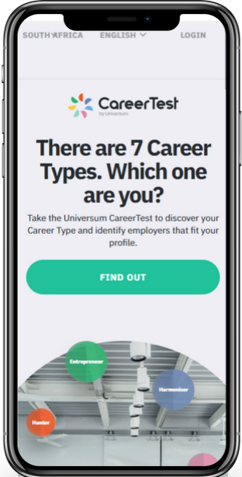




















How we collect our data
2021 | South Africa | Professionals | All main fields of study
We collaborate with partners around the globe to help create a more transparent world around education and career readiness.
As part of our mission to connect talent with the future, we go straight to the source using our flagship tool, the CareerTest by Universum.
We collaborate with partners all over the world, including universities, student associations and related organisations.
We not only help partners better understand their students, alumni and professionals but we also give relevant career advice and even help with how partners can increase collaboration with top employers.

Slide 7





























Global clients
For over 30 years, we have been the trusted Employer Branding partner to many of the world’s best-known employers.
Our data, insights, and guidance shapes employer branding and assists employers from around the globe in their efforts to attract, recruit and retain the right talent.
By following the World’s Most Attractive Employers, we can analyze the desires of talent to learn how those desires align with the perception of the employers themselves. Understanding the motivations of candidates will help organizations of any size be better prepared to attract and retain talent.
Learn more: https://universumglobal.com/about-universum/

Slide 8
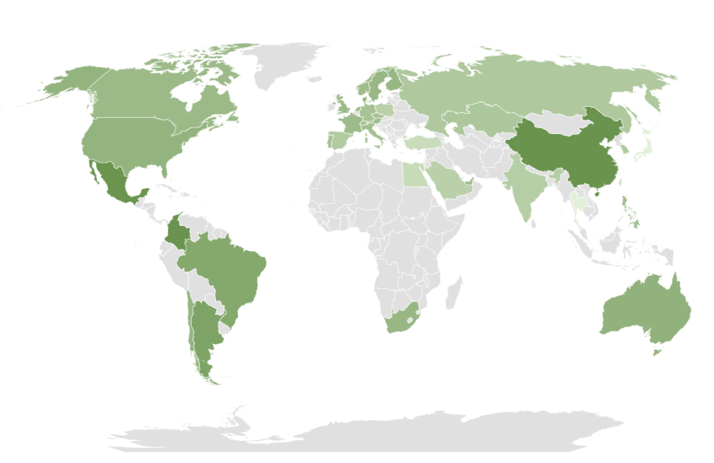
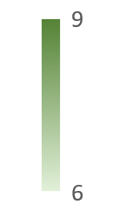
Global university satisfaction rate 2020
2021 | South Africa | Professionals | All main fields of study
University satisfaction rate
9
6
How satisfied are/were you with your college or university? (0 – Not at all satisfied, 10 – Very satisfied)

Slide 9




This report helps you to…
2021 | South Africa | Professionals | All main fields of study
UNDERSTAND
YOUR ALUMNI
LEARN
ABOUT YOUR BRAND
DEVELOP
FROM COMPARISONS
Dive into your alumni’s career & communication preferences.
Understand why alumni are (not) satisfied with your alumni services.
Get a reality check of your alumni’s expectations – are their expectations being met in the labor market?
Gauge your alumni’s opinion on your university brand.
Learn what is unique about your university brand.
Understand where your university and its perception by your alumni is standing in the market.
Compare different groups of alumni internally as well as with other alumni on national and international levels.
Pinpoint your alumni’s skills in comparison to their peers.
Compare your alumni’s employer preferences with those of other alumni.

Slide 10
Table of contents
  1
This chapter focuses on the demographic background of your talent, their competencies, their experiences and how they relate to the comparison group.
These results will help you to contextualize findings in later sections and have a starting point in improving the employability of your talent by being able to communicate their unique value to employers.
  INTRODUCTION
  2
  TALENT PROFILE

Slide 11

The Universum CareerTest 2021
2021 | South Africa | Professionals | All main fields of study
The Questionnaire
Our survey is conducted online. The link was distributed via university and talent-networks, alumni communities, the Universum Panel and various other local and global partners.
Survey participants
Professionals with an academic degree
Number of survey participants in this report
FIELD PERIOD
September 2020 - February 2021
Your alumni
2 833
Total number of
Survey participants
38 435
All professionals
38 435
Total number of
Survey participants last year
814
25 759
Your alumni last year

Slide 12
Demographic profile of talent covered in this report
2021 | South Africa | Professionals | All main fields of study
Gender
Women
Men

Slide 13
Highest educational qualification
2021 | South Africa | Professionals | All main fields of study
Your alumni
All professionals
What's the highest educational qualification or degree that you've earned?

Slide 14





2021 | South Africa | Professionals | All main fields of study
The Universum Career Profiles
Go-Getter
Go-Getters have a strong performance orientation. They’re ambitious achievers, hungry to make their mark in successful companies with a reputation for top talent. They’re comfortable taking on high levels of responsibility and tough challenges. In return for their dedicated effort and ability to make things happen, they expect high levels of recognition and fast-track career progress.
Globe-Trotter
Globe-Trotters have a strong international orientation. They have a cosmopolitan outlook, seeking to broaden their horizons in a multi-national company that will provide the opportunity to travel abroad and interact with a diverse international community of colleagues, clients and customers. They see constant change as a positive, broadening their experience and stimulating their learning.
Ground-Breaker
Ground-Breakers have a strong entrepreneurial orientation. They’d ideally prefer to work within a dynamic, team-oriented, start-up environment, with a strong focus on innovation. They’re less interested in working for an established player, and more focused on embracing the latest technologies to create new and exciting products, and lead developments in their chosen field.
Change-Maker
Change-Makers have a strong purpose orientation. They’re altruistic by nature and seek organisations that serve the common good, through public service, or social enterprise. They’re strong believers in diversity, equity and inclusion, and feel most engaged when they’re serving a higher purpose or simply helping people.
Balance-Seeker
Balance-Seekers have a strong work-life balance orientation. They generally seek well-established, small to medium sized organisations with a friendly, family feel, providing a decent salary and the flexibility for people to balance their responsibilities at work with their wider interests and responsibilities outside of work.

Slide 15

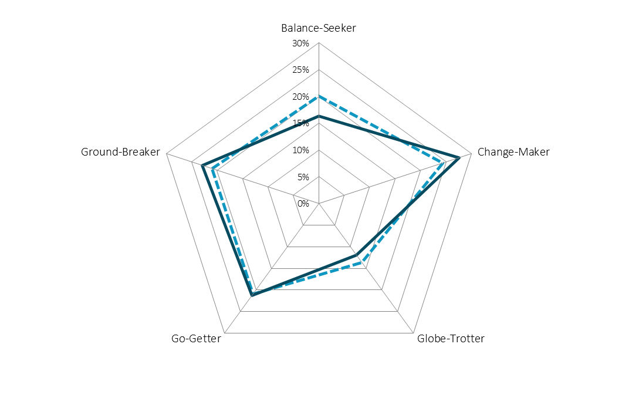




The Universum Career Types
2021 | South Africa | Professionals | All main fields of study
DOMINANT CAREER TYPES:
Your alumni
Change-Maker
Ground-Breaker
Go-Getter
Your alumni
All professionals
DOMINANT CAREER TYPES:
All professionals
Change-Maker
Ground-Breaker
Go-Getter

Slide 16
Your alumni's soft skills assessment (1/2)
2021 | South Africa | Professionals | All main fields of study
I'm able to clearly communicate what I want to say most of the time
I tend to challenge the status quo and create new things
Strongly agree
Agree
Slightly agree
I feel confident when I have challenging problems to solve
I work better on my own than in a team
Slightly disagree
Disagree
Strongly disagree
How much do you agree with the following statements?

Slide 17
Your alumni's soft skills assessment (2/2)
2021 | South Africa | Professionals | All main fields of study
I find it easy to learn new skills
I tend to take initiatives to make things happen
Strongly agree
Agree
Slightly agree
I like frequent change
I feel most engaged when I'm helping people
Slightly disagree
Disagree
Strongly disagree
How much do you agree with the following statements?

Slide 18
Your alumni's personality assessment (1/2)
2021 | South Africa | Professionals | All main fields of study
I'd prefer to visit somewhere familiar
than go somewhere new while on holiday
I'm more likely to carry out my plans through to the end
than lose interest halfway
Strongly agree
Agree
Slightly agree
I find networking more exhausting than invigorating
When someone upsets me, I'm more likely
to walk away than confront them
Slightly disagree
Disagree
Strongly disagree
How much do you agree with the following statements?

Slide 19
Your alumni's personality assessment (2/2)
2021 | South Africa | Professionals | All main fields of study
I'm more likely to open-up and
share my feelings rather than keep them to myself
I can always tell a fake smile from a real one
Strongly agree
Agree
I'd rather have a job that's calm
and stress-free than constantly challenging
I'd rather be a part of the team than the team leader
Slightly agree
Slightly disagree
Disagree
Strongly disagree
How much do you agree with the following statements?

Slide 20
Table of contents
  1
This chapter evaluates your university brand perception with regards to four different drivers:
Reputation
Offering
Culture
Employability
This will help you adjust your communication towards current students as well as determine which topics are best suited for use when attracting new students.
  INTRODUCTION
  2
  TALENT PROFILE
  3
  UNIVERSITY AND BRAND PERCEPTION

Slide 21

What do your alumni think about your university?
2021 | South Africa | Professionals | All main fields of study
What's the first word that comes to your mind when you think of your college or university?
These are answers were provided by your talent.
Spelling mistakes might occur.
Different colors have been used for design purposes only & reflect the associations of your talent.

Slide 22

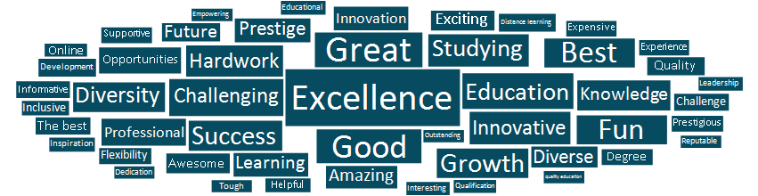
Is your image distinct?
2021 | South Africa | Professionals | All main fields of study
Your alumni
All professionals
What's the first word that comes to your mind when you think of your college or university?
These are answers were provided by your talent.
Spelling mistakes might occur.
Different colors have been used for design purposes only & reflect the associations of your talent.

Slide 23
Influences on decisions where to study
2021 | South Africa | Professionals | All main fields of study
Your alumni
All professionals
What helped you most when choosing your college and university? (Please select a maximum of 3 alternatives.)

Slide 24
Less important influence factors for your school’s selection
2021 | South Africa | Professionals | All main fields of study
Your alumni
All professionals
What helped you most when choosing your college and university? (Please select a maximum of 3 alternatives.)

Slide 25
Would talent choose their university again?
2021 | South Africa | Professionals | All main fields of study
Your alumni
All professionals
Attend a different college or university within this country
Attend a different college or university within this country
Attend a college or university abroad
Attend a college or university abroad
Attend the same college or university
Attend the same college or university
Seek employment instead of going to college or university
Seek employment instead of going to college or university
If you were to restart your studies, what would you do?

Slide 26
Which universities would your alumni choose instead?
2021 | South Africa | Professionals | All main fields of study
Universities your alumni would have chosen instead (Percent)
  1. University of Pretoria (UP) (19%)
  2. University of Cape Town (UCT) (17%)
  3. University of Witwatersrand (WITS) (17%)
  4. Stellenbosch University (SUN) (11%)
  5. University of Johannesburg (UJ) (9%)
  7. University of South Africa (UNISA) (3%)
  7. University of the Free State (UFS) (3%)
  9. University of KwaZulu Natal (UKZN) (2%)
  10. Rhodes University (RU) (1%)
  10. Sefako Makgatho University (SMU) (1%)
18%
…of your alumni said they would attend a different college or university in your country if they could choose again
WHERE ARE THESE SCHOOLS STRONGER THAN YOU ARE?
They are associated with these important attributes to a higher extent than you are!
  Internationally renowned
  Good employment opportunities
  Good reference for future career and/or education
  Opportunities to network with employers
  Research excellence
If you were to restart your studies, what would you do?
Which university or college would you rather have attended?
Which of the following attributes do you associate with your college or university? (Please select as many as applicable.)

Slide 27
The Universum Drivers of University Attractiveness
2021 | South Africa | Professionals | All main fields of study
Reputation
Culture
Alumni hold leadership positions
Drives changes in society
Drives innovation and/or entrepreneurship
Educational excellence
Heritage and tradition
Internationally renowned
Research excellence
Studying with the best students
Successful alumni
Unique programs
Affordability of studies
Attractive location
Creative and dynamic atmosphere
Friendly and open environment
Good meal plans / cafeterias
Institutional commitment to diversity and inclusion
International student body
Safe campus environment
Support for gender equality
Wide range of extracurricular activities
Employability
Offering
Focus on professional development
Good employment opportunities
Good reference for future career and/or education
Launching pad for international career
Opportunities to network with employers
Strong ties with industry
Supports and develops entrepreneurialism
Supports and develops innovation
Target school for employers in my field
Teaching skills employers are looking for
Adequate teacher/student ratio
Availability of study space
Easy access to study materials
Excellent professors/lecturers
High quality of programs
Interdisciplinary courses
Programs/opportunities to study abroad
Stimulating learning environment
Teaching relevant skills
Variety of courses

Slide 28
The most important attributes - Top 10
2021 | South Africa | Professionals | All main fields of study
Your alumni
All professionals
Reputation
Culture
Employability
Offering
Which of these are most important to you? Please select a maximum of 3 alternatives.

Slide 29
The top 10 attributes your alumni associate with you
2021 | South Africa | Professionals | All main fields of study
Your alumni
All professionals
Your alumni
Reputation
Culture
Employability
Offering
Which of the following attributes do you associate with your college or university? Select as many as applicable.

Slide 30
The biggest changes from 2020 to 2021 - Importance
2021 | South Africa | Professionals | All main fields of study
Your alumni
All professionals
Your students
Rank
2021
2020
Rank
2021
2020
Increased in importance
Rank
2021
2020
Rank
2021
2020
Decreased in importance
Reputation
Culture
Employability
Offering
Which of these aspects are most important to you? (Please select a maximum of 3 alternatives.)

Slide 31
The biggest changes from 2020 to 2021 - Association
2021 | South Africa | Professionals | All main fields of study
Your alumni
All professionals
Your students
Rank
2021
2020
Rank
2021
2020
Increased in association
Rank
2021
2020
Rank
2021
2020
Decreased in association
Reputation
Culture
Employability
Offering
Which of the following attributes do you associate with your college or university? Select as many as applicable.

Slide 32
The most important attributes per Driver of University Attractiveness
2021 | South Africa | Professionals | All main fields of study
Your alumni
REPUTATION
Culture
Employability
Offering
2021:
2021:
2021:
2021:
1. Educational excellence
2. Research excellence
3. Internationally renowned
1. Safe campus environment
2. Affordability of studies
3. Friendly and open environment
1. Good employment opportunities
2. Focus on professional development
3. Good reference for future career and/or education
1. High quality of programs
2. Excellent professors/lecturers
3. Teaching relevant skills
2020:
2020:
2020:
2020:
1. Educational excellence
2. Research excellence
3. Internationally renowned
1. Safe campus environment
2. Affordability of studies
3. Friendly and open environment
1. Good employment opportunities
2. Focus on professional development
3. Good reference for future career and/or education
1. High quality of programs
2. Excellent professors/lecturers
3. Teaching relevant skills
Which of these are most important to you? (Please select a maximum of 3 alternatives.)

Slide 33
The most associated attributes per Driver of University Attractiveness
2021 | South Africa | Professionals | All main fields of study
Your alumni
REPUTATION
Culture
Employability
Offering
2021:
2021:
2021:
2021:
1. Educational excellence
2. Research excellence
3. Successful alumni
1. Safe campus environment
2. Friendly and open environment
3. Affordability of studies
1. Good reference for future career and/or education
2. Focus on professional development
3. Teaching skills employers are looking for
1. Excellent professors/lecturers
2. High quality of programs
3. Easy access to study materials
2020:
2020:
2020:
2020:
1. Educational excellence
2. Successful alumni
3. Research excellence
1. Safe campus environment
2. Friendly and open environment
3. Attractive location
1. Good reference for future career and/or education
2. Focus on professional development
3. Teaching skills employers are looking for
1. High quality of programs
2. Excellent professors/lecturers
3. Easy access to study materials
Which of the following attributes do you associate with your college or university? (Please select as many as applicable.)

Slide 34
The most important attributes per Driver of University Attractiveness
2021 | South Africa | Professionals | All main fields of study
All professionals
REPUTATION
Culture
Employability
Offering
2021:
2021:
2021:
2021:
1. Educational excellence
2. Research excellence
3. Internationally renowned
1. Affordability of studies
2. Safe campus environment
3. Friendly and open environment
1. Good employment opportunities
2. Focus on professional development
3. Good reference for future career and/or education
1. High quality of programs
2. Excellent professors/lecturers
3. Teaching relevant skills
2020:
2020:
2020:
2020:
1. Educational excellence
2. Research excellence
3. Internationally renowned
1. Affordability of studies
2. Safe campus environment
3. Friendly and open environment
1. Good employment opportunities
2. Focus on professional development
3. Good reference for future career and/or education
1. High quality of programs
2. Excellent professors/lecturers
3. Easy access to study materials
Which of these are most important to you? (Please select a maximum of 3 alternatives.)

Slide 35
The most associated attributes per Driver of University Attractiveness
2021 | South Africa | Professionals | All main fields of study
All professionals
REPUTATION
Culture
Employability
Offering
2021:
2021:
2021:
2021:
1. Educational excellence
2. Research excellence
3. Successful alumni
1. Affordability of studies
2. Friendly and open environment
3. Safe campus environment
1. Good reference for future career and/or education
2. Focus on professional development
3. Good employment opportunities
1. Easy access to study materials
2. Variety of courses
3. High quality of programs
2020:
2020:
2020:
2020:
1. Educational excellence
2. Research excellence
3. Successful alumni
1. Affordability of studies
2. Friendly and open environment
3. Safe campus environment
1. Good reference for future career and/or education
2. Focus on professional development
3. Good employment opportunities
1. Easy access to study materials
2. Variety of courses
3. High quality of programs
Which of the following attributes do you associate with your college or university? (Please select as many as applicable.)

Slide 36
The following slides present an aggregated analysis of all 40 attributes from the Drivers of University Attractiveness
2021 | South Africa | Professionals | All main fields of study
Association
Attractive
The attributes most strongly associated with you among alumni, regardless of the driver.
Your image
What talent wants
The overall most attractive attributes among your alumni, regardless of the driver.
Attractive and credible attributes
Attributes that are both among the most attractive and most strongly associated.
These attributes show what made your alumni happy to be at school.

Slide 37
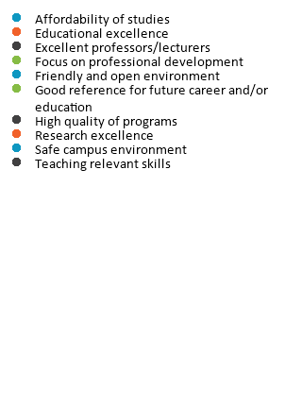
What is attractive and associated with you?
2021 | South Africa | Professionals | All main fields of study
Attractive and associated attributes
Associated
Associated
Attractive
Reputation
Culture
Employability
Offering
Which of the following attributes do you associate with your college or university? (Please select as many as applicable.)
Which of these are most important to you? (Please select a maximum of 3 alternatives.)

Slide 38
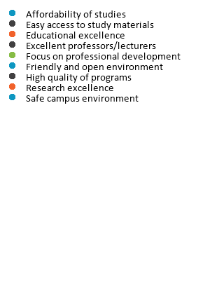
Are these attributes differentiating for you?
2021 | South Africa | Professionals | All main fields of study
Attractive and associated attributes 2021
Attractive and associated attributes 2020
Reputation
Culture
Employability
Offering

Slide 39
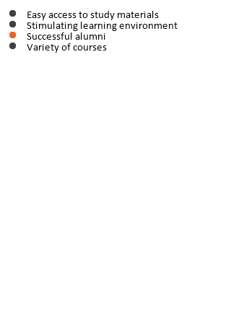
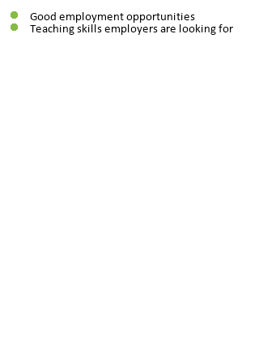

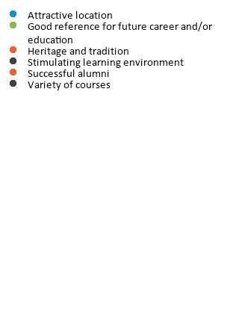
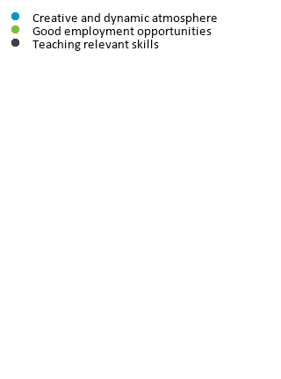
Are your target group’s preferences aligned with their perception of you?
2021 | South Africa | Professionals | All main fields of study
Associated but not attractive attributes 2021:
Attractive but not associated attributes 2021:
Associated but not attractive attributes 2020:
Attractive but not associated attributes 2020:
Reputation
Culture
Employability
Offering

Slide 40
Success stories vs Improvement areas
2021 | South Africa | Professionals | All main fields of study
Where do alumni see you excel? (Top 3)
What needs to be improved? (Top 3)
Below you find the attributes that you think are important and associated with your college/university. Which of these do think your school excels at?
Below you find the attributes that you think are important but are not associated with your college/university. Which of these do you think your school needs to urgently improve?
The percentage of those who say you excel at these attributes is based on the alumni who find this attribute important and associate it with their school.
The percentage of those who say that this attribute needs to be improved are based on the alumni who find this attribute important but do not associate it with their school.

Slide 41
Gender differences in attribute importance
2021 | South Africa | Professionals | All main fields of study
More attractive to women
Same importance
More attractive to men
Ranking position
Ranking position
Ranking position
Which of these are most important to you? (Please select a maximum of 3 alternatives.)
Ranking positions 1 to 40 expressing where the attribute ranks for your alumni.

Slide 42
Gender differences in university brand perception
2021 | South Africa | Professionals | All main fields of study
More associated by women
Same association
More associated by men
Ranking position
Ranking position
Ranking position
Which of the following attributes do you associate with your college or university? (Please select as many as applicable.)
Ranking positions 1 to 40 expressing where the attribute ranks for your alumni.

Slide 43
Competitor comparison
2021 | South Africa | Professionals | All main fields of study
Understanding what your alumni think about their school by comparing their ratings to a wider context
100%
Highest value in the comparison group
100%
100%
Example 1:
Very diverse distribution across the different comparison schools.
Strongest 10% of colleges/universiities
Half of the
colleges/
universities
has a value in
this range
90%
90%
90%
80%
70%
Percentage of alumni who associate their college/
university with the attribute
80%
Your performance
80%
Strongest 10-20%
60%
50%
70%
70%
Strongest 20-30%
40%
30%
60%
60%
Strongest 30-40%
20%
10%
50%
50%
Strongest 40-50%
0%
Average performance
40%
40%
Weakest 40-50%
Half of the
colleges/
universities
has a value in
this range
Weakest 30-40%
100%
Example 2:
Very dense distribution across the different comparison schools with a group of outliers at the top.
30%
30%
90%
Weakest 20-30%
80%
20%
20%
70%
Weakest 10-20%
60%
10%
Lowest value in the comparison group
10%
50%
Weakest 10% of colleges/universiities
40%
0%
0%
30%
20%
10%
0%

Slide 44
Where do you stand regarding reputation?
2021 | South Africa | Professionals | All main fields of study
Your alumni
Average
Most attractive
Strongest 10-20%
Strongest 20-30%
Strongest 30-40%
Strongest 40-50%
Weakest 40-50%
Weakest 30-40%
Weakest 20-30%
Weakest 10-20%
Weakest 10%
Minimum
Maximum
The attributes are sorted by importance
Which college or university do you attend? / At which college or university did you achieve your highest academic degree?.
Which of the following attributes do you associate with your college or university? (Please select as many as applicable.)
Which of these aspects are most important to you? (Please select a maximum of 3 alternatives.)

Slide 45
Reputation
2021 | South Africa | Professionals | All main fields of study
Most frequent associations
Your alumni
All professionals
Which of the following attributes do you associate with your college or university? (Please select as many as applicable.)

Slide 46
Where do you stand regarding offering?
2021 | South Africa | Professionals | All main fields of study
Your alumni
Average
Most attractive
Strongest 10-20%
Strongest 20-30%
Strongest 30-40%
Strongest 40-50%
Weakest 40-50%
Weakest 30-40%
Weakest 20-30%
Weakest 10-20%
Weakest 10%
Minimum
Maximum
The attributes are sorted by importance
Which college or university do you attend? / At which college or university did you achieve your highest academic degree?.
Which of the following attributes do you associate with your college or university? (Please select as many as applicable.)
Which of these aspects are most important to you? (Please select a maximum of 3 alternatives.)

Slide 47
Offering
2021 | South Africa | Professionals | All main fields of study
Most frequent associations
Your alumni
All professionals
Which of the following attributes do you associate with your college or university? (Please select as many as applicable.)

Slide 48
Where do you stand regarding culture?
2021 | South Africa | Professionals | All main fields of study
Your alumni
Average
Most attractive
Strongest 10-20%
Strongest 20-30%
Strongest 30-40%
Strongest 40-50%
Weakest 40-50%
Weakest 30-40%
Weakest 20-30%
Weakest 10-20%
Weakest 10%
Minimum
Maximum
The attributes are sorted by importance
Which college or university do you attend? / At which college or university did you achieve your highest academic degree?.
Which of the following attributes do you associate with your college or university? (Please select as many as applicable.)
Which of these aspects are most important to you? (Please select a maximum of 3 alternatives.)

Slide 49
Culture
2021 | South Africa | Professionals | All main fields of study
Most frequent associations
Your alumni
All professionals
Which of the following attributes do you associate with your college or university? (Please select as many as applicable.)

Slide 50
Where do you stand regarding employability?
2021 | South Africa | Professionals | All main fields of study
Your alumni
Average
Most attractive
Strongest 10-20%
Strongest 20-30%
Strongest 30-40%
Strongest 40-50%
Weakest 40-50%
Weakest 30-40%
Weakest 20-30%
Weakest 10-20%
Weakest 10%
Minimum
Maximum
The attributes are sorted by importance
Which college or university do you attend? / At which college or university did you achieve your highest academic degree?.
Which of the following attributes do you associate with your college or university? (Please select as many as applicable.)
Which of these aspects are most important to you? (Please select a maximum of 3 alternatives.)

Slide 51
Employability
2021 | South Africa | Professionals | All main fields of study
Most frequent associations
Your alumni
All professionals
Which of the following attributes do you associate with your college or university? (Please select as many as applicable.)

Slide 52
Which driver is your brand leaning to according to your alumni ?
2021 | South Africa | Professionals | All main fields of study
University Reputation
and Image
Culture
Your alumni
associate
17
out of 40 attributes with their school. Other alumni associate 16 attributes with their schools.
4 attributes
4 attributes
Employability & Future
Opportunities
Offering
4 attributes
5 attributes
Which of the following attributes do you associate with your college or university? (Please select as many as applicable.)
Note, the list of attributes shown here cuts across all four Drivers of Employer Attractiveness (i.e. out of 40 attributes), as opposed to by each individual Driver.
Outer circle shows data of Your alumni.
Inner circle shows data of All professionals.

Slide 53
University satisfaction
2021 | South Africa | Professionals | All main fields of study
Not at all satisfied
Extremely satisfied
Average rate 2021:
Average rate 2021:
8,3
7,7
Your alumni
All professionals
How satisfied are/were you with your college or university?

Slide 54
University satisfaction over time
2021 | South Africa | Professionals | All main fields of study
Average rate 2021
8,3
Your alumni
Average rate 2021
7,7
All professionals
Your alumni
All professionals
How satisfied are/were you with your college or university?

Slide 55
Satisfaction across main fields of study
2021 | South Africa | Professionals | All main fields of study
Your alumni
All professionals
How satisfied are/were you with your college or university?

Slide 56
Satisfaction across gender per main field of study
2021 | South Africa | Professionals | All main fields of study
Female
Male
Your alumni
All professionals
How satisfied are/were you with your college or university?:

Slide 57
Table of contents
  1
This chapter illustrates which alumni services your talent uses, which services they deem important, and how satisfied they are with the currently offered services.
This will help you to tactically focus on the alumni services that are in highest demand and are most effective for your talent
  INTRODUCTION
  2
TALENT PROFILE
  3
  UNIVERSITY AND BRAND PERCEPTION
  4
  ALUMNI SERVICES

Slide 58
General usage of alumni services
2021 | South Africa | Professionals | All main fields of study
Your alumni
All professionals
Share of professionals answering yes
Share of professionals answering yes
Share of professionals answering no
Share of professionals answering no
Have you used the alumni services offered at your college or university? (Yes / No)

Slide 59
% of alumni not using any alumni services
2021 | South Africa | Professionals | All main fields of study
% of alumni not using any career services
Your alumni
Year
All professionals
Have you used the alumni services offered at your college or university?
Average rate 2019:
Average rate 2019:

Slide 60
% of alumni not using any alumni services
2021 | South Africa | Professionals | All main fields of study
Your alumni
All professionals
Have you used the alumni services offered at your college or university?
Average rate 2019:
Average rate 2019:

Slide 61
Why are some alumni not using any of the career services?
2021 | South Africa | Professionals | All main fields of study
Your alumni
All professionals
Why don't you use the alumni services offered at your college or university?

Slide 62
Satisfaction with alumni service
2021 | South Africa | Professionals | All main fields of study
Satisfaction with alumni services
Poor
Excellent
Average rate 2021:
Average rate 2021:
7,4
7,3
Your alumni
All professionals
How would you rate the alumni services offered at your college or university? (0 - Poor, 10 - Excellent)

Slide 63
Alumni service satisfaction over time
2021 | South Africa | Professionals | All main fields of study
Average rate 2021
7,4
Your alumni
Average rate 2021
7,3
All professionals
Your alumni
All professionals
How would you rate the alumni services offered at your college or university? (0 - Poor, 10 - Excellent)
The X-axis of the chart was limited to the score values 4 to 10 for better readability

Slide 64
Your alumni’s preferred services
2021 | South Africa | Professionals | All main fields of study
Your alumni
All professionals
Which services would you like your university to offer alumni?

Slide 65
Your alumni’s preferred information
2021 | South Africa | Professionals | All main fields of study
Your alumni
All professionals
What would you like to hear about from the university/alma mater?

Slide 66
Your alumni’s preferred ways of involvement
2021 | South Africa | Professionals | All main fields of study
Your alumni
All professionals
How would like to get involve with your alma mater?

Slide 67
Your alumni’s preferred contact frequency
2021 | South Africa | Professionals | All main fields of study
Your alumni
All professionals
How often would you like your university / alma mater to contact you?

Slide 68
Recommended communication channels for alumni service information
2021 | South Africa | Professionals | All main fields of study
Your alumni
All professionals
What channels would you like your alumni service to use to communicate with you? (Please select as many as applicable.)

Slide 69
Table of contents
  1
This chapter covers how your talent prefers to communicate and interact with employers.
This will assist you in indicating to your talent in where their peers are successful communicators. Additionally, this data educates employers regarding which platforms they should use to engage your talent.
  INTRODUCTION
  2
  TALENT PROFILE
  3
  UNIVERSITY AND BRAND PERCEPTION
  4
  ALUMNI SERVICES
  5
COMMUNICATION

Slide 70
Which channels do your alumni use to learn about employers?
2021 | South Africa | Professionals | All main fields of study
94%
of the alumni use digital channels.
(98%)*
6,4
67%
of the alumni use in-person channels.
(66%)
is the number of channels talent use on average to learn about employers, compared to 5,8 in 2020
67%
of the alumni use print channels.
(64%)
Your alumni
*(2020 data)
All professionals
Through which channels have you learnt about these employers in the last 12 months?

Slide 71
Communication channels – Top 15
2021 | South Africa | Professionals | All main fields of study
Your alumni
All professionals
Through which channels have you learnt about these employers in the last 12 months?

Slide 72
Communication channels – Top 15
2021 | South Africa | Professionals | All main fields of study
2021
2020
Through which channels have you learnt about these employers in the last 12 months?

Slide 73
Most offered and widely received career development activities/services | Your alumni
2021 | South Africa | Professionals | All main fields of study
Below data is based on talent who have attended any career development related events in the past 12 months.
Available activities/services
Participation in the available activities/services
Participated
Not participated
Have you attended any career development related events (career fairs, conferences, company presentations, etc.) in the past 12 months?
Which activities/services were available?
Have you attended any career development related events (career fairs, conferences, company presentations, etc.) in the past 12 months?
Which activities/services were available?
Which activities/services did you participate in or use?

Slide 74
Most offered and widely received career development activities/services | All professionals
2021 | South Africa | Professionals | All main fields of study
Below data is based on talent who have attended any career development related events in the past 12 months.
Available activities/services
Participation in the available activities/services
Participated
Not participated
Have you attended any career development related events (career fairs, conferences, company presentations, etc.) in the past 12 months?
Which activities/services were available?
Have you attended any career development related events (career fairs, conferences, company presentations, etc.) in the past 12 months?
Which activities/services were available?
Which activities/services did you participate in or use?

Slide 75
Preferred format for participation
2021 | South Africa | Professionals | All main fields of study
Your alumni
How would you prefer to participate in the following activities?

Slide 76
Most used online platforms
2021 | South Africa | Professionals | All main fields of study
Used in general
Used to learn about employers
Your alumni
All professionals
Which of these online platforms do you use? (Please choose as many as applicable.)
Which of these platforms do you use to inform yourself about employers? (Please choose as many as applicable.)

Slide 77
Important topics to focus on when posting on online channels
2021 | South Africa | Professionals | All main fields of study
To help increase engagement!
Your alumni
All professionals
How important is it for you to see the following types of information on employers' online channels?
This graph shows the percentage of respondents answered important to very important on a range of Very important to Not important

Slide 78
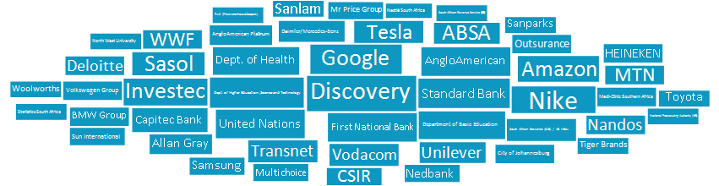
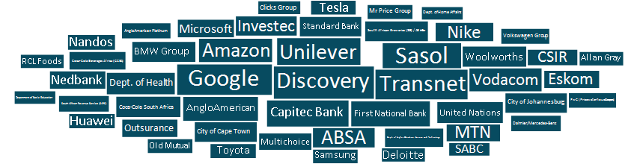
Employers with the most impressive social media presence
2021 | South Africa | Professionals | All main fields of study
Your alumni
All professionals
Which employer has impressed you the most with its social media activities in the last 12 months?

Slide 79
Communication overview – Your alumni
2021 | South Africa | Professionals | All main fields of study
Most used communication channels
to learn about employers
Participation in the available activities/services
Most used online platforms
Most used participation formats
Most used online platforms
to learn about employers

Slide 80
Communication overview – All professionals
2021 | South Africa | Professionals | All main fields of study
Most used communication channels
to learn about employers
Participation in the available activities/services
Most used online platforms
Most used participation formats
Most used online platforms
to learn about employers

Slide 81
Table of contents
  1
This chapter focuses on the employer attributes that are most attractive to your talent Moreover, it covers your talent’s preferred choice of employers, including their ideal employers.
You will discover how well aligned your talent’s preferences are with the reality of the labor market. You can thereby identify which employers are top of mind for your talent and which ones are not currently successful at attracting your talent.
  INTRODUCTION
  2
  TALENT PROFILE
  3
  UNIVERSITY AND BRAND PERCEPTION
  4
  ALUMNI SERVICES
  5
COMMUNICATION
  6
CAREER AND EMPLOYER PREFERENCES

Slide 82
Preferred type of employment
2021 | South Africa | Professionals | All main fields of study
Your alumni
All professionals
Full time
Full time
Part time
Part time
Freelance/ gig-work
Freelance/ gig-work
What type of employment would you prefer?

Slide 83
Organization type preferences | Your alumni vs All professionals
2021 | South Africa | Professionals | All main fields of study
Organizational maturity
Size
Operations
Established organization
Large organization
Organization with operations mainly in South Africa
Start-up
Small to medium sized organization
Organization with global operations
Origin
Sector
Location
Organization founded in South Africa
Private sector
Large city
Organization founded outside of South Africa
Public sector
Small to medium sized town
If you have to choose one, where would you prefer to work?

Slide 84
Organization type preferences | Gender comparison
2021 | South Africa | Professionals | All main fields of study
Organizational maturity
Size
Operations
Established organization
Large organization
Organization with operations mainly in South Africa
Start-up
Small to medium sized organization
Organization with global operations
Origin
Sector
Location
Organization founded in South Africa
Private sector
Large city
Organization founded outside of South Africa
Public sector
Small to medium sized town
If you have to choose one, where would you prefer to work?

Slide 85
Current annual salary (ZAR)
2021 | South Africa | Professionals | All main fields of study
Business/Commerce
Engineering/Technology
All Professionals 2021
Sciences
407 434
481 641
415 146
403 884
461 222
509 770
473 315
463 420
356 738
425 585
371 934
355 496
GENDER
GAP
104 484
84 186
101 381
107 924
What is your current salary before taxes (including commission and bonus, excluding pension)?

Slide 86
Current salary by gender | Your alumni vs All professionals
2021 | South Africa | Professionals | All main fields of study
Current annual salary (ZAR)
Your alumni
All professionals
331 504
366 096
382 738
426 940
296 781
325 404
GENDER
GAP
85 957
101 536
What’s your current salary before taxes (including commission and bonus, excluding pension)?
Gender:

Slide 87
Your alumni’s employment status
2021 | South Africa | Professionals | All main fields of study
Your alumni
All professionals
What best matches your current employment status?

Slide 88
Your alumni's satisfaction with their current employer
2021 | South Africa | Professionals | All main fields of study
Average satisfaction
Your alumni:
6,5
All professionals:
6,1
Very dissatisfied
Very satisfied
How satisfied are you with your current employer? (0 - Very dissatisfied, 10 - Very satisfied)

Slide 89
Your alumni's interest in changing an employer
2021 | South Africa | Professionals | All main fields of study
47%
of your alumni are interested in changing their employer within the coming year.
of the target population is interested in changing their employer within the coming year.
Are you interested in changing employers?
The results show your target group's opinions of their current employer.

Slide 90
In which industries do your alumni work?
2021 | South Africa | Professionals | All main fields of study
Your alumni
All professionals
Industry

Slide 91
The Universum Drivers of Employer Attractiveness
2021 | South Africa | Professionals | All main fields of study
Employer Reputation & Image
People & Culture
The attributes of the employer as an organisation
The social environment and attributes of the workplace
Attractive/exciting products and services
Corporate Social Responsibility
Embracing new technologies
Ethical standards
Fast-growing/entrepreneurial
Innovation
Inspiring leadership
Inspiring purpose
Market success
Prestige
A creative and dynamic work environment
A friendly work environment
Commitment to diversity and inclusion
Encouraging work-life balance
Interaction with international clients and colleagues
Leaders who will support my development
Opportunities to make a personal impact
Recognizing performance (meritocracy)
Recruiting only the best talent
Respect for its people
Remuneration & Advancement Opportunities
Job Characteristics
The monetary compensation and other benefits,
now and in the future
The contents and demands of the job, including the earning
opportunities provided by the job
Clear path for advancement
Competitive base salary
Competitive benefits
Good reference for future career
High future earnings
Leadership opportunities
Performance-related bonus
Rapid promotion
Sponsorship of future education
Support for gender equality
Challenging work
Customer focus
Flexible working conditions
High level of responsibility
High performance focus
Opportunities for international travel/relocation
Professional training and development
Secure employment
Team-oriented work
Variety of assignments

Slide 92
What does your talent find most important in an employer?
2021 | South Africa | Professionals | All main fields of study
Your alumni
Employer Reputation & Image
People & Culture
1. Ethical standards
2. Inspiring leadership
3. Innovation
1. Leaders who will support my development
2. Respect for its people
3. Encouraging work-life balance
ReMuNeration & Advancement opportunities
Job characteristics
1. Leadership opportunities
2. Clear path for advancement
3. Competitive base salary
1. Professional training and development
2. Secure employment
3. Flexible working conditions
Which of the following are most important to you? (Please select a maximum of 3 alternatives.)

Slide 93
The top 10 most important attributes
2021 | South Africa | Professionals | All main fields of study
Your alumni
All professionals
Employer Reputation & Image
People & Culture
Remuneration & Advancement Opportunities
Job Characteristics
How important are each of these aspects to you?
Which of the following are most important to you? (Please select a maximum of 3 alternatives.)
This is the attractiveness of the 40 attributes in relation to how important respondents think its driver is. This analysis gives a summarised 360 degree view of what influences employer attractiveness.

Slide 94
The biggest changes from 2020 to 2021 – Employer preferences
2021 | South Africa | Professionals | All main fields of study
Your alumni
All professionals
Your students
Rank
2021
2020
Rank
2021
2020
Increased in importance
Rank
2021
2020
Rank
2021
2020
Decreased in importance
Employer Reputation & Image
People & Culture
Remuneration & Advancement Opportunities
Job Characteristics
Which of the following are most important to you? (Please select a maximum of 3 alternatives.)

Slide 95

The Universum Rankings
2021 | South Africa | Professionals | All main fields of study
FULL COMPANY LIST
Considered Employer ranking
Ideal Employer ranking
Potential applicants’
ranking
(100-150 employers within each main field of study)
(as many as applicable)
(maximum five employers)
(Yes, definitely)
“Below is a list of employers. Please select which employers you would consider working for.”
“Now choose the five (5) employers you most want to work for, your five Ideal Employers.”
“If you were looking for a new job, would you consider applying at these employers?”
The employers’ names might be shortened in this report for layout reasons.

Slide 96
Considered employer ranking | Top 20
2021 | South Africa | Professionals | All main fields of study
Your alumni | Business/Commerce
All professionals | Business/Commerce
Below is a list of employers. Please select which employers you would consider working for.

Slide 97
Considered employer ranking | Top 20
2021 | South Africa | Professionals | All main fields of study
Your alumni | Engineering/Technology
All professionals | Engineering/Technology
Below is a list of employers. Please select which employers you would consider working for.

Slide 98
Considered employer ranking | Top 20
2021 | South Africa | Professionals | All main fields of study
Your alumni | Sciences
All professionals | Sciences
Below is a list of employers. Please select which employers you would consider working for.

Slide 99
Ideal Employer ranking | Top 20
2021 | South Africa | Professionals | All main fields of study
Your alumni | Business/Commerce
All professionals | Business/Commerce
Now choose the five (5) employers you most want to work for, your five Ideal Employers.

Slide 100
Ideal Employer ranking | Top 20
2021 | South Africa | Professionals | All main fields of study
Your alumni | Engineering/Technology
All professionals | Engineering/Technology
Now choose the five (5) employers you most want to work for, your five Ideal Employers.

Slide 101
Ideal Employer ranking | Top 20
2021 | South Africa | Professionals | All main fields of study
Your alumni | Sciences
All professionals | Sciences
Now choose the five (5) employers you most want to work for, your five Ideal Employers.

Slide 102
Ideal Employer ranking | Top 20 comparison
2021 | South Africa | Professionals | All main fields of study
Business/Commerce
Now choose the five (5) employers you most want to work for, your five Ideal Employers.

Slide 103
Ideal Employer ranking | Top 20 comparison
2021 | South Africa | Professionals | All main fields of study
Engineering/Technology
Now choose the five (5) employers you most want to work for, your five Ideal Employers.

Slide 104
Ideal Employer ranking | Top 20 comparison
2021 | South Africa | Professionals | All main fields of study
Sciences
Now choose the five (5) employers you most want to work for, your five Ideal Employers.

Slide 105
Potential applicants’ ranking | Top 20
2021 | South Africa | Professionals | All main fields of study
Your alumni | Business/Commerce
All professionals | Business/Commerce
If you were looking for a new job, would you consider applying to these employers? – Yes, definitely.

Slide 106
Potential applicants’ ranking | Top 20
2021 | South Africa | Professionals | All main fields of study
Your alumni | Engineering/Technology
All professionals | Engineering/Technology
If you were looking for a new job, would you consider applying to these employers? – Yes, definitely.

Slide 107
Potential applicants’ ranking | Top 20
2021 | South Africa | Professionals | All main fields of study
Your alumni | Sciences
All professionals | Sciences
If you were looking for a new job, would you consider applying to these employers? – Yes, definitely.

Slide 108
Table of contents
  1
  INTRODUCTION
  2
  TALENT PROFILE
  3
  UNIVERSITY AND BRAND PERCEPTION
  4
  ALUMNI SERVICES
  5
COMMUNICATION
  6
CAREER AND EMPLOYER PREFERENCES
  7
SUMMARY

Slide 109



General Talent Outlook | Your alumni vs All professionals
2021 | South Africa | Professionals | All main fields of study
Your alumni
All professionals
38%
62%
38%
62%
Top career profiles
Top occupation groups
Top career profiles
Top occupation groups
Change-Maker
Ground-Breaker
Go-Getter
Education
Accountancy
Administration
Change-Maker
Ground-Breaker
Go-Getter
Administration
Education
Accountancy
Most important attributes
Current salary per year
Most important attributes
Current salary per year
331 504
366 096
ZAR
ZAR
Least important attributes
Management responsibility
Least important attributes
Management responsibility
No management responsibility (57%)
Lower management (22%)
Middle management (12%)
Senior management (5%)
No management responsibility (51%)
Lower management (23%)
Middle management (15%)
Senior management (7%)

Slide 110
2021 | South Africa | Professionals | All main fields of study
APPENDIX

Slide 111
Employee satisfaction – Your alumni vs. All professionals
2021 | South Africa | Professionals | All main fields of study
6,5
is the average satisfaction in 2021.
Very dissatisfied
Very satisfied
How satisfied are you with your current employer?
Scale: 0 = Very dissatisfied and 10 = Very satisfied

Slide 112
Employee advocacy – Your alumni
2021 | South Africa | Professionals | All main fields of study
The EB Net Promoter Score is a tool that can be used to gauge employee advocacy.
Not likely at all
Extremely likely
Detractors
Passives
Promoters
46%
30%
24%
How likely are you to recommend your current employer to a friend?
The EB Net Promoter Score is an index ranging from -100 to 100, calculated by subtracting the percentage of promoters from the percentage of detractors and multiplying by 100.

Slide 113
Employee advocacy – All professionals
2021 | South Africa | Professionals | All main fields of study
The EB Net Promoter Score is a tool that can be used to gauge employee advocacy.
Not likely at all
Extremely likely
Detractors
Passives
Promoters
53%
27%
20%
How likely are you to recommend your current employer to a friend?
The EB Net Promoter Score is an index ranging from -100 to 100, calculated by subtracting the percentage of promoters from the percentage of detractors and multiplying by 100.

Slide 114
Are professionals interested in changing their employer?
2021 | South Africa | Professionals | All main fields of study
47%
of your target talent are interested in changing employer within the coming year.
57%
of all professionals is interested in changing employer within the coming year.
Are you interested in changing employers?
The results show your target group's opinions of their current employer.
Industries are not comparable due to change in list.

Slide 115
How trust impacts employee’s decision to stay or leave their job
2021 | South Africa | Professionals | All main fields of study
Below data is based on talent who completely agreed on each of the below statements
No Interest in changing job
within 4 year’s time
Interest in changing job
within a year’s time
How much do you agree with the following statements?

Slide 116
Reputation & Image
2021 | South Africa | Professionals | All main fields of study
Attractiveness by main field of study
Most attractive
One of top 3 important attributes among alumni at each main field of study
The attributes are sorted by importance
(average of all target schools)
Which of these are most important to you? Please select a maximum of three alternatives.
Which of the following attributes do you associate with your college or university? (Please select as many as applicable.)
The attributes are sorted according to their overall importance.
Details on the importance of each attribute per school can be found in the Appendix.

Slide 117
Culture and Student Life
2021 | South Africa | Professionals | All main fields of study
Attractiveness by main field of study
Most attractive
One of top 3 important attributes among alumni at each main field of study
The attributes are sorted by importance
(average of all target schools)
Which of these are most important to you? Please select a maximum of three alternatives.
Which of the following attributes do you associate with your college or university? (Please select as many as applicable.)
The attributes are sorted according to their overall importance.
Details on the importance of each attribute per school can be found in the Appendix.

Slide 118
Employability and Future Offering
2021 | South Africa | Professionals | All main fields of study
Attractiveness by main field of study
Most attractive
One of top 3 important attributes among alumni at each main field of study
The attributes are sorted by importance
(average of all target schools)
Which of these are most important to you? Please select a maximum of three alternatives.
Which of the following attributes do you associate with your college or university? (Please select as many as applicable.)
The attributes are sorted according to their overall importance.
Details on the importance of each attribute per school can be found in the Appendix.

Slide 119
Offering
2021 | South Africa | Professionals | All main fields of study
Attractiveness by main field of study
Most attractive
One of top 3 important attributes among alumni at each main field of study
The attributes are sorted by importance
(average of all target schools)
Which of these are most important to you? Please select a maximum of three alternatives.
Which of the following attributes do you associate with your college or university? (Please select as many as applicable.)
The attributes are sorted according to their overall importance.
Details on the importance of each attribute per school can be found in the Appendix.

Slide 120
Do you stand for what’s important to your talent?
2021 | South Africa | Professionals | All main fields of study
Your average association
Important areas where your university rates low
–
consider whether to adapt communication
Important areas where your university rates highly
–
continue communicating
Attractiveness within the target group
Attribute’s average importance
Less important areas where your university rates low
–
monitor / no action
Less important areas where your university rates highly
–
keep as is
Attributes that your alumni associate with your university

Slide 121
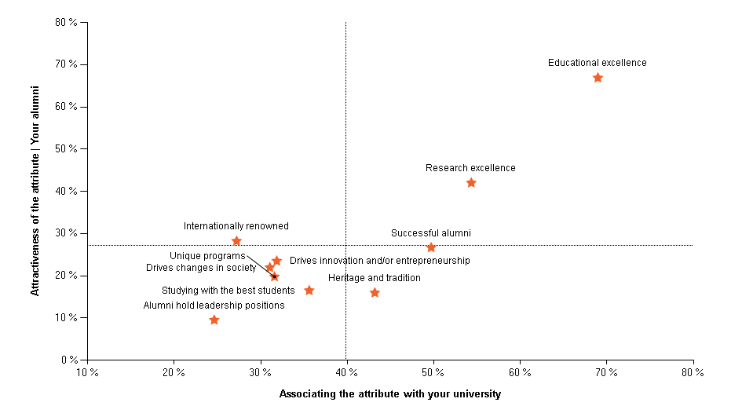
Reputation & Image
2021 | South Africa | Professionals | All main fields of study
Attractiveness vs. Associations with North West University (NWU)
Which of the following attributes do you associate with your college or university? Select as many as applicable.
Which of these are most important to you? (Max. 3)

Slide 122
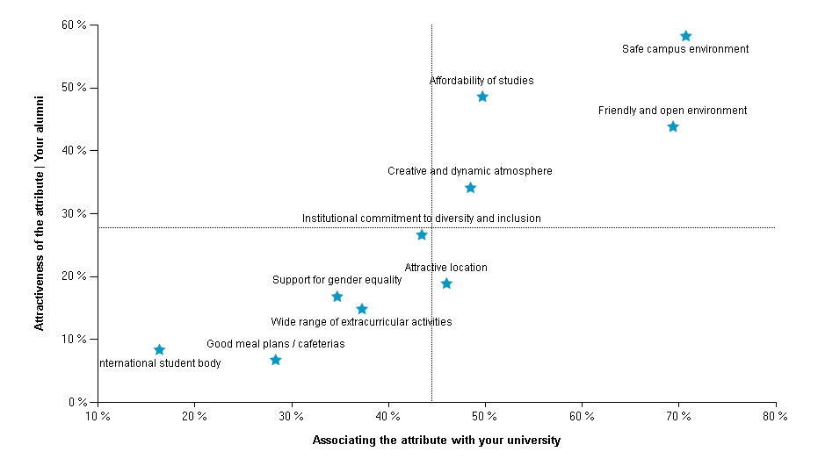
Culture and Student Life
2021 | South Africa | Professionals | All main fields of study
Attractiveness vs. Associations with North West University (NWU)
Which of the following attributes do you associate with your college or university? Select as many as applicable.
Which of these are most important to you? (Max. 3)

Slide 123
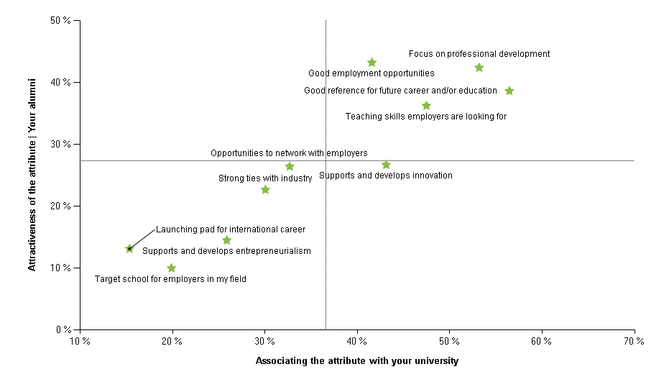
Employability and Future Offering
2021 | South Africa | Professionals | All main fields of study
Attractiveness vs. Associations with North West University (NWU)
Which of the following attributes do you associate with your college or university? Select as many as applicable.
Which of these are most important to you? (Max. 3)

Slide 124
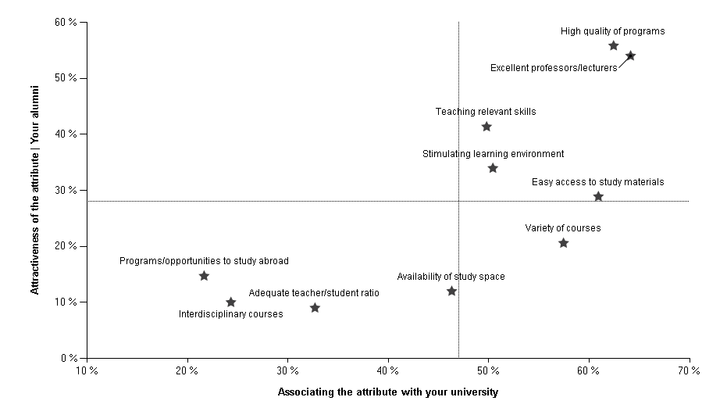
Offering
2021 | South Africa | Professionals | All main fields of study
Attractiveness vs. Associations with North West University (NWU)
Which of the following attributes do you associate with your college or university? Select as many as applicable.
Which of these are most important to you? (Max. 3)

Slide 125
Areas of study
2021 | South Africa | Professionals | All main fields of study
Your alumni : Business (1/1)
Please select your major(s)/main area(s) of study.

Slide 126
Areas of study
2021 | South Africa | Professionals | All main fields of study
Your alumni : Humanities (1/1)
Please select your major(s)/main area(s) of study.

Slide 127
Areas of study
2021 | South Africa | Professionals | All main fields of study
All professionals : Business (1/2)
Please select your major(s)/main area(s) of study.

Slide 128
Areas of study
2021 | South Africa | Professionals | All main fields of study
All professionals : Business (2/2)
Please select your major(s)/main area(s) of study.

Slide 129
Areas of study
2021 | South Africa | Professionals | All main fields of study
All professionals : Engineering (1/2)
Please select your major(s)/main area(s) of study.

Slide 130
Areas of study
2021 | South Africa | Professionals | All main fields of study
All professionals : Engineering (2/2)
Please select your major(s)/main area(s) of study.

Slide 131
Areas of study
2021 | South Africa | Professionals | All main fields of study
All professionals : Natural Sciences (1/1)
Please select your major(s)/main area(s) of study.

Slide 132
Areas of study
2021 | South Africa | Professionals | All main fields of study
All professionals : Humanities (1/1)
Please select your major(s)/main area(s) of study.

Slide 133
Areas of study
2021 | South Africa | Professionals | All main fields of study
All professionals : Law (1/1)
Please select your major(s)/main area(s) of study.

Slide 134
Areas of study
2021 | South Africa | Professionals | All main fields of study
All professionals : Health/Medicine (1/1)
Please select your major(s)/main area(s) of study.

Slide 135
Considered employer ranking | Top 30
2021 | South Africa | Professionals | All main fields of study
All professionals | Business/Commerce
Below is a list of employers. Please select which employers you would consider working for.

Slide 136
Considered employer ranking | Top 30
2021 | South Africa | Professionals | All main fields of study
All professionals | Engineering/Technology
Below is a list of employers. Please select which employers you would consider working for.

Slide 137
Considered employer ranking | Top 30
2021 | South Africa | Professionals | All main fields of study
All professionals | Sciences
Below is a list of employers. Please select which employers you would consider working for.

Slide 138
Ideal Employer ranking | Top 30
2021 | South Africa | Professionals | All main fields of study
All professionals | Business/Commerce
Now choose the five (5) employers you most want to work for, your five Ideal Employers.

Slide 139
Ideal Employer ranking | Top 30
2021 | South Africa | Professionals | All main fields of study
All professionals | Engineering/Technology
Now choose the five (5) employers you most want to work for, your five Ideal Employers.

Slide 140
Ideal Employer ranking | Top 30
2021 | South Africa | Professionals | All main fields of study
All professionals | Sciences
Now choose the five (5) employers you most want to work for, your five Ideal Employers.

Slide 141
Potential applicants’ ranking | Top 30
2021 | South Africa | Professionals | All main fields of study
All professionals | Business/Commerce
If you were looking for a new job, would you consider applying to these employers? – Yes, definitely.

Slide 142
Potential applicants’ ranking | Top 30
2021 | South Africa | Professionals | All main fields of study
All professionals | Engineering/Technology
If you were looking for a new job, would you consider applying to these employers? – Yes, definitely.

Slide 143
Potential applicants’ ranking | Top 30
2021 | South Africa | Professionals | All main fields of study
All professionals | Sciences
If you were looking for a new job, would you consider applying to these employers? – Yes, definitely.

Slide 144
Thank you!

